Slide 1
How to insure a smooth transition from printing towards online publishing? How http://dissem.in can help?
Marie Farge
Centre National à la Recherche Scientifique (CNRS)
and Ecole Normale Supérieure Paris (ENS)
April 28th 2017
National Fusion Research Institute
Daejeon, Korea
http://openscience.ens.fr/MARIE_FARGE/

Slide 2
Green Open Access is the wisest model !
Today publishers own scientific journals and control bibliometry,
that they use as a marketing tool to insure their control.
The Gold Open Access model leads to the creation
of predatory journals of very poor quality, even fake journals.
To avoid this and to guarantee a smooth transition towards open access,
researchers would like to preserve the main traditional journals
which are useful, having a good reputation and good practices.
The wisest solution is the Green Open Access model, i.e.,
researchers should keep the academic freedom to publish
their articles in the journals they prefer, and at the same time
deposit a version in a public open repository.
http://openscience.ens.fr/MARIE_FARGE

Slide 3
Dissemin to boost Green Open Access
Antonin Delpeuch, a student in computer sciences from ENS Paris,
created in September 2014 the plateform http://dissem.in,
that is collectively developed in open source.
‘Spot your own paywalled papers.
Liberate them in one click!’

Slide 4
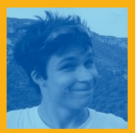
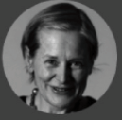
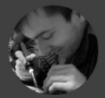
The team CAPSH / Dissemin
http://dissem.in is supported by the not-for-profit association CAPSH
(Committee for the Accessibility of Publications in Sciences and Humanities)
created on September 5th 2015 by :
Creator and main developer
of the platform Dissemin
2016
Antoine Amarilli
Pablo Rauzy
Marie Farge
Thomas Bourgeat

Slide 5
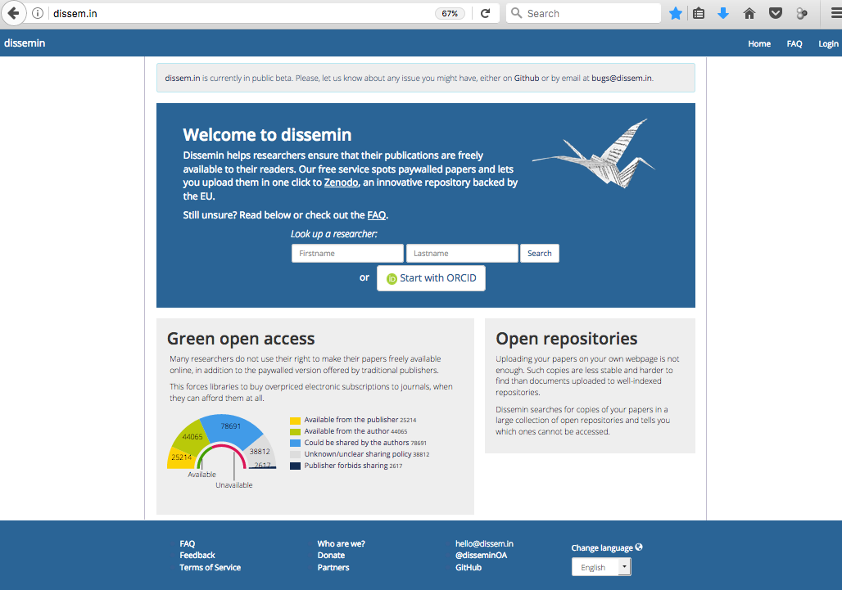
Dissemin lists the articles of any researcher

Slide 6
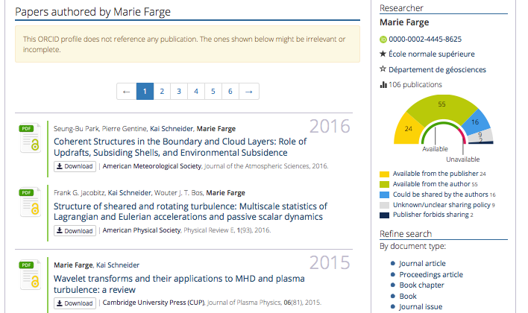
Papers already
in open access can
be downloaded :

Slide 7
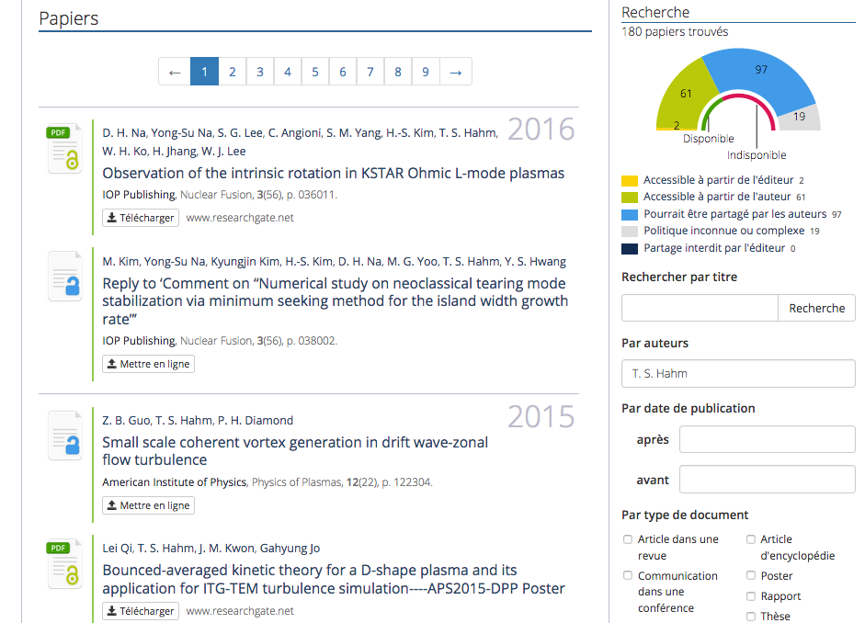

Slide 8
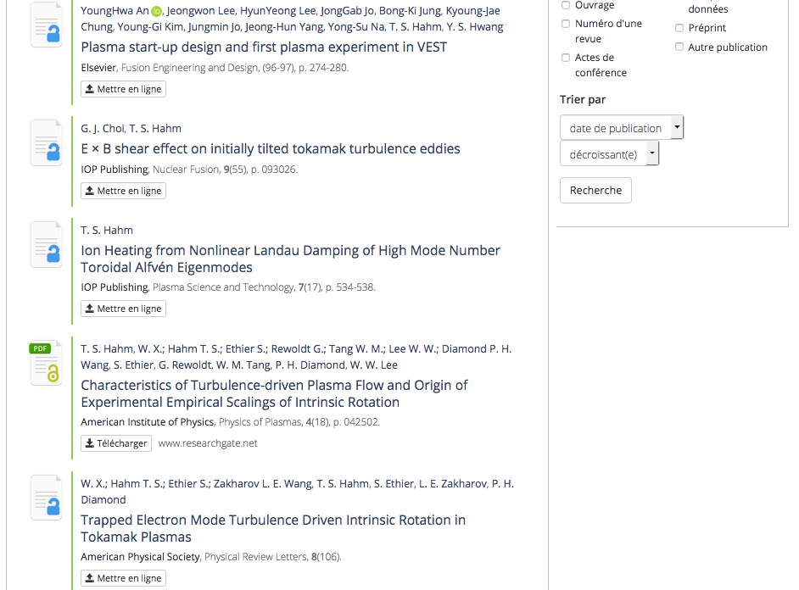

Slide 9
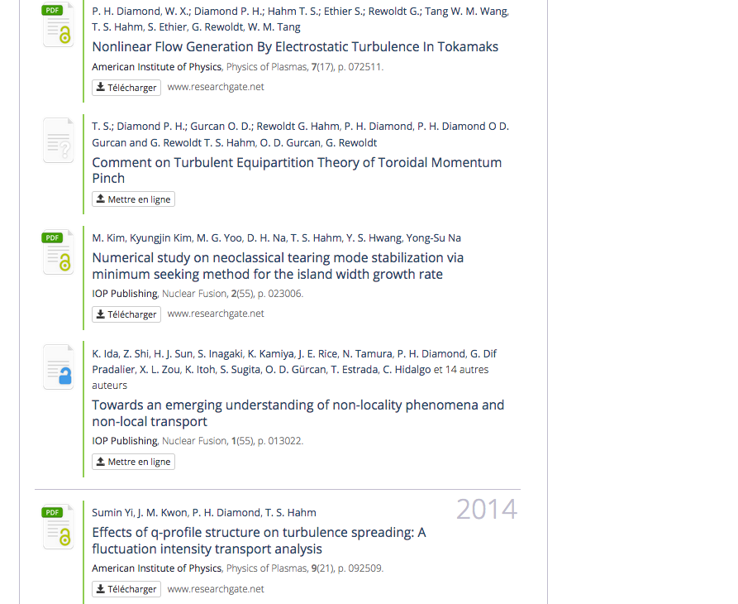

Slide 10
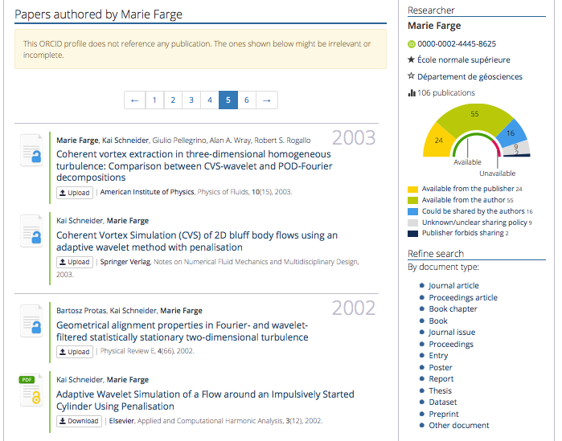
Papers not yet
in open access can
be deposited :

Slide 11
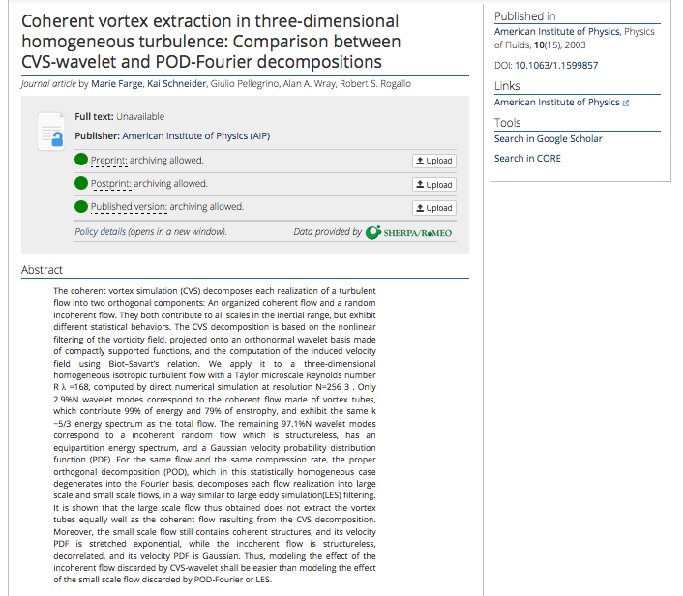
For each article
Dissemin checks
if the publisher
allows to deposit
the paper, and
which version.

Slide 12
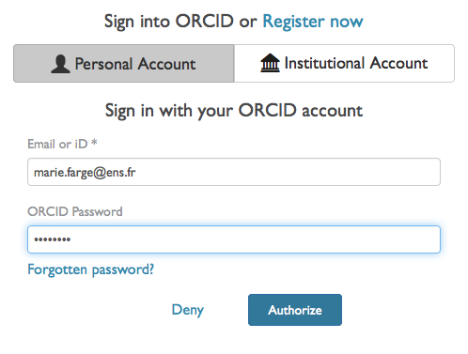
How to liberate your article from paywalls
Authors should register and identify themselves to be able to deposit their article.

Slide 13
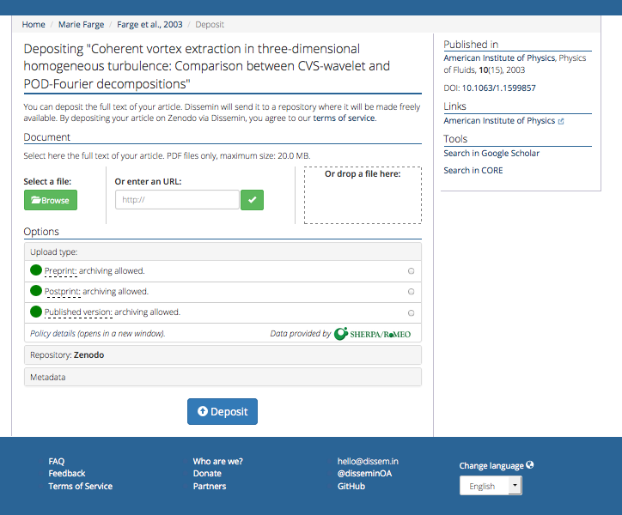
First click
to choose
the version
to deposit

Slide 14
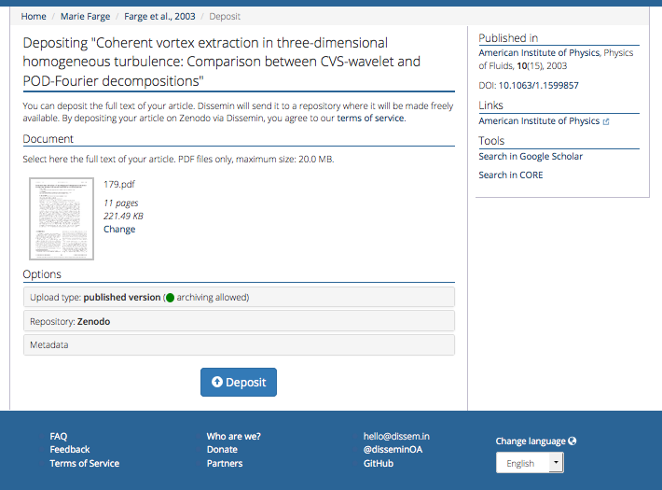
Second click
to deposit
in Zenodo

Slide 15
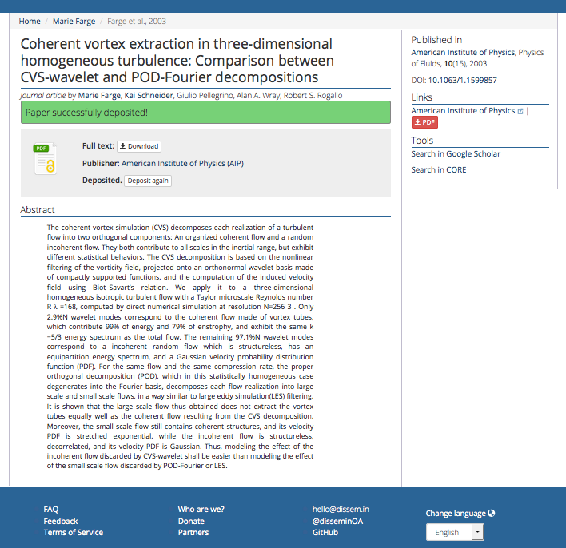
Anyone can now download
your article for free
from Zenodo,
the open repository of
CERN that is funded by
the European Commission
as part of the network
OpenAIRE.

Slide 16
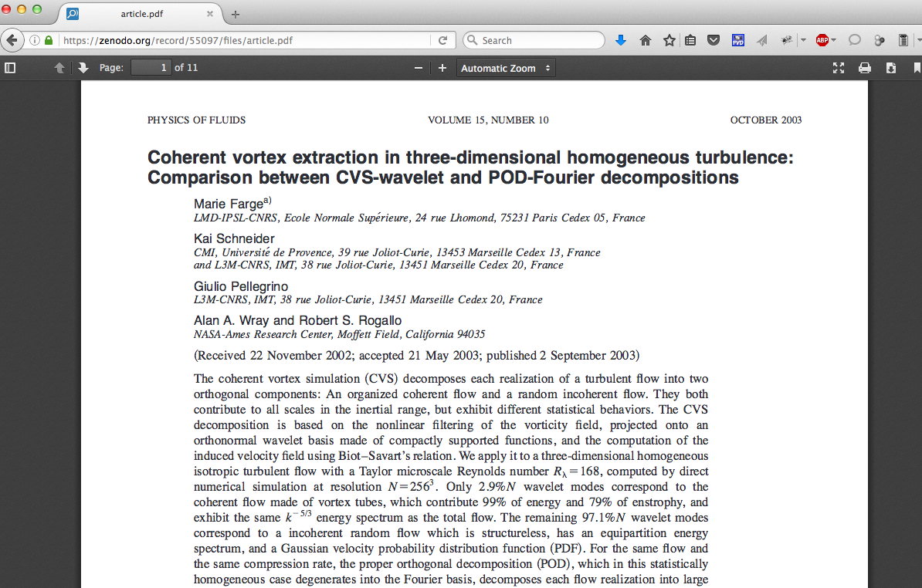
Your article is now in open access

Slide 17
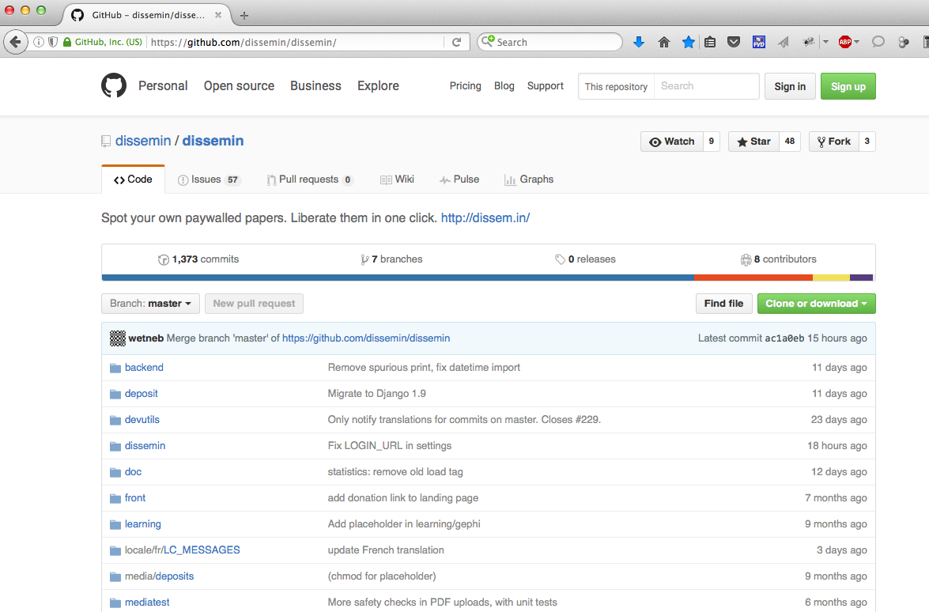
The source of Dissemin is open on GitHub

Slide 18
You can follow the development of Dissemin
Antonin
Ryan
You are also welcome to participate to its development in Python !

Slide 19
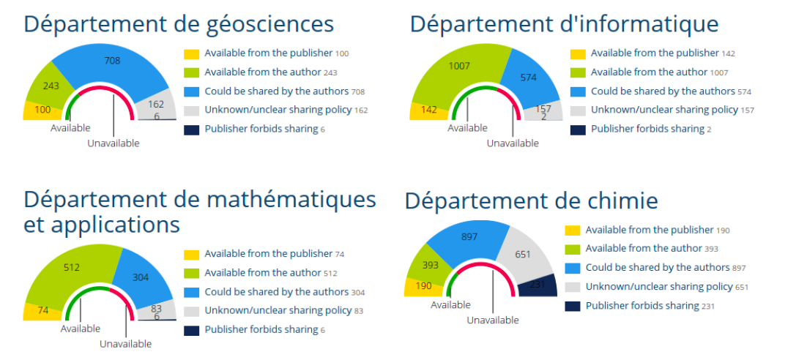
How to list the articles of an institution
With Dissemin you can generate the list of the scholarly articles
published by the researchers of an institution and get some statistics.
Here is the example of Ecole Normale Supérieure Paris :
http://dissem.in/institution/1/

Slide 20
http://dissem.in/institution/1/

Slide 21
'Scholarly publishing and peer-reviewing in open access’, Marie Farge, 2017
in 'Europe’s Future: Open Science, Open Innovation, and Open to the World’, European Commission, DG Research, Science and Innovation, April 2017
http://openscience.ens.fr/
http://openscience.ens.fr/MARIE_FARGE/
http://wavelets.ens.fr
http://dissem.in
http://new.dissem.in
http://association.dissem.in
https://github.com/dissemin
@disseminOA
Antonin Delpeuch <antonin@delpeuch.eu>
Marie Farge <marie.farge@ens.fr>
Team Dissemin <team@dissem.in>

