Slide 1
How could
the scientific publishing system
be reformed?
Marie Farge
CNRS (Centre National à la Recherche Scientifique)
and ENS (Ecole Normale Supérieure) Paris
Open Science as a Common Good
European Parliament, Brussels
May 3rd 2017

Slide 2
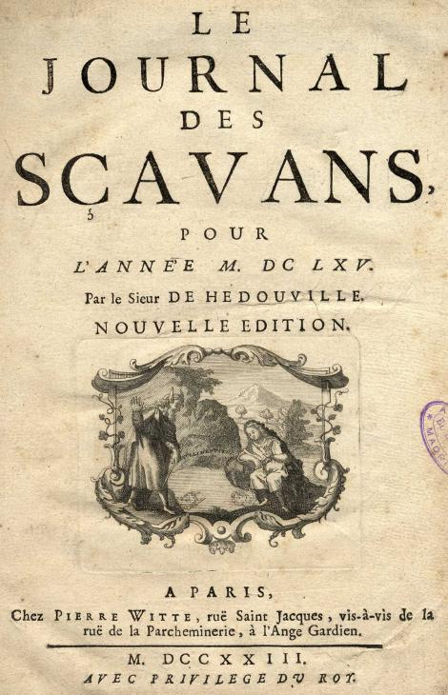
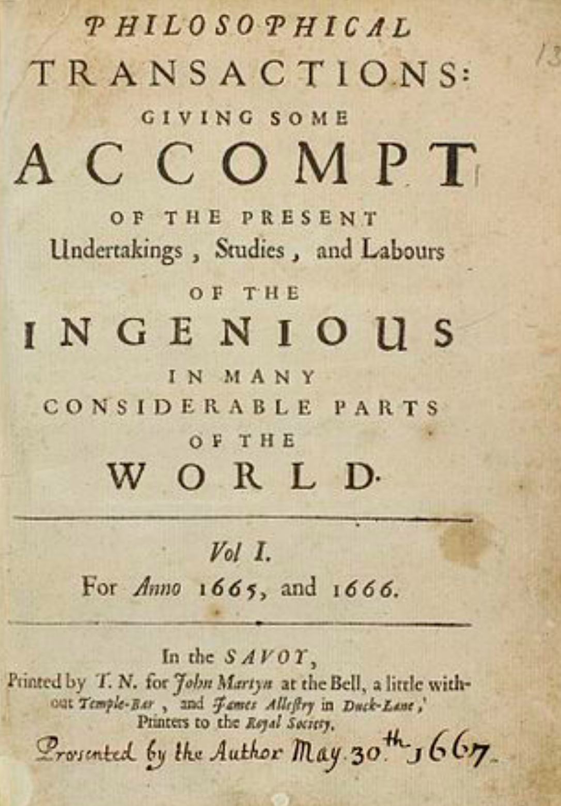
Peer-reviewed scientific journals
The publication of research results in peer-reviewed journals
is the backbone of the present research system.
It was founded on January 5th 1665 for sharing ideas and results.
It is also used today for evaluating researchers and projects.
The scientific publishing system is based on the
business model of printing:
journals belong to publishers,
researchers peer-review articles without being paid
by publishers for this,
then articles are printed
and sold by publishers
to academic libraries.
Paris, 5th January 1665
London, 6th March 1665

Slide 3
Who has access to peer-reviewed articles ?
Only researchers who work in institutions and countries rich enough
to afford the very costly subscriptions to peer-reviewed journals.
Researchers working for companies, or in poor institutions,
teachers, students, retired researchers, and all citizens who finance
public research do not have access to most of scientific articles.
Publishers do benefit from the digital revolution and use
online publishing to reduce their costs (marginal cost is about 0),
while preserving their business model designed for printing.
Today few major publishers have acquired an oligopolistic position.
Vincent Larivière et al.,
The Oligopoly of Academic Publishers,
PLOS one, 10th June 2015

Slide 4
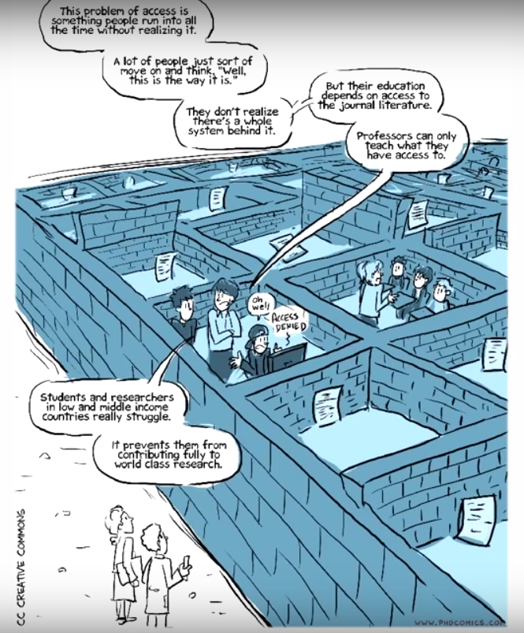
Articles are still
locked behind
paywalls
Since 2000
most renown journals
have been bought by few major publishers,
whose exceptional profits rely on the work
that researchers and their funding agencies
offer them for free.
What is Open Access?
www.phdcomics.com/TV

Slide 5
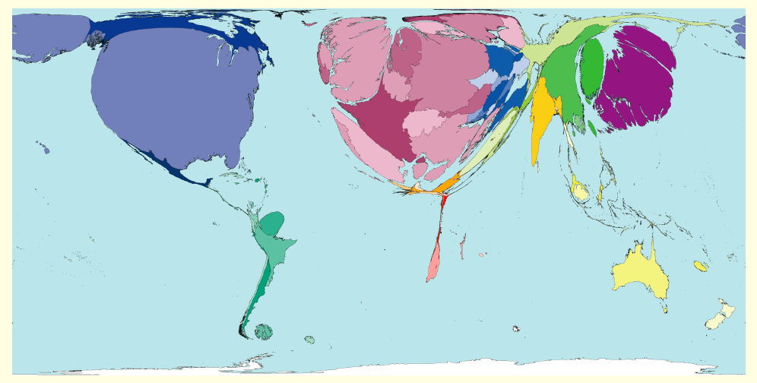
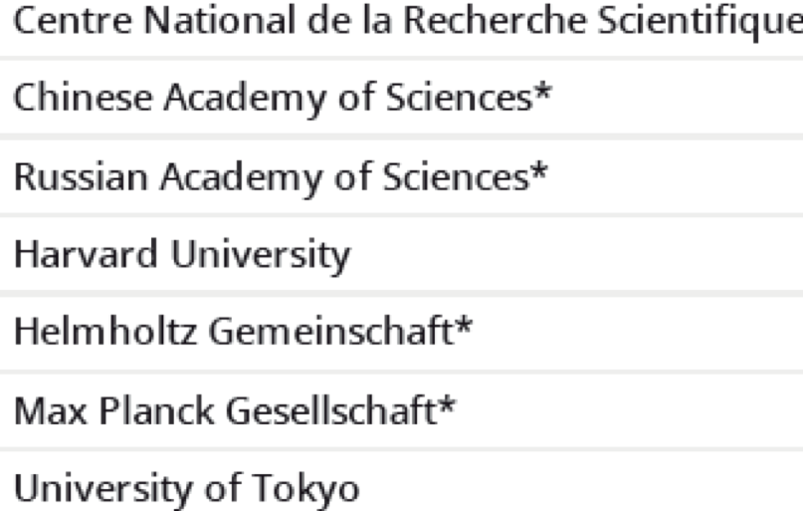
Density of peer-reviewed articles per country
Number of articles
per number of inhabitants
of each country
http://www.worldmapper.org
Today publishers impose the
Gold Open Access model,
which flips subscription costs
into article processing charges that
researchers have to pay to publish
researchers might get bankrupted
or stop publishing!
http://www.scimagoir.com

Slide 6
How could the scientific publishing system be reformed?

Slide 7
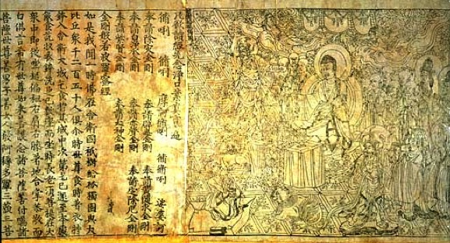
Researchers want to recover control !
`Neither author nor reader should have to pay to publish and a
journal should not belong to its publisher but to its editorial board.
The dissemination of the peer-reviewed articles should be done using
public infrastructures, from where articles should be accessible for free.’
Marie Farge, Note for the French Minister of Research, June 29th 2012
http://openscience.ens.fr/MARIE_FARGE/
Researchers proposed
an alternative model :
Diamond Open Access
Diamond Sutra,
the earliest complete survival
of a dated printed book,
China, 11th May 868
British Library, London

Slide 8
The Diamond Open Access model
1
Authors keep their copyright and make
their articles available in open access
with a Creative Commons license CC-BY.
https://creativecommons.org/licenses/
2
The editorial board owns the journal (title and assets), while
the editors and referees peer-review the articles for free,
as they have ever done since it is part of their academic duty.
3
The publisher is no more the journal’s owner but
becomes a service provider, that the editorial board
selects the best ones and hires them by contract.

Slide 9
Researchers need publishing platforms
Public funding agencies should provide for free to researchers
publicly-owned platforms, developed in open source software,
for peer-reviewing, publishing and archiving peer-reviewed articles,
with the help of librarians and of publishers (as subcontractors).
Anyone from anywhere should have free access (i.e., gratis and libre)
to any peer-reviewed publication (e.g., articles, data, codes, videos)
without researchers having to pay to publish their results.
Funding agencies could thus control the quality of peer-reviewing,
by selecting journals having good practices and reputable editors,
that will then be published for free using publishing platforms.
Such publishing platforms could give the chance to researchers
to experiment new ways of publishing (e.g., open peer-reviewing).

Slide 10
How to insure a smooth transition from printed publishing to online publishing?

Slide 11
Green Open Access is the wisest model !
Today, publishers own peer-reviewed journals and bibliometric tools, which insures their control of the scientific publishing system.
Today, publishers try to impose to researchers and funding agencies
the Gold Open Access model where one has to pay to publish,
but this leads to the rise of predatory journals of very poor quality.
To insure a smooth transition to Open Acces
the wisest solution is the Green Open Access model
researchers keep the academic freedom to publish
their articles in the journals they prefer, and at the same time
deposit a version of each article in a public open repository.
http://openscience.ens.fr/MARIE_FARGE

Slide 12
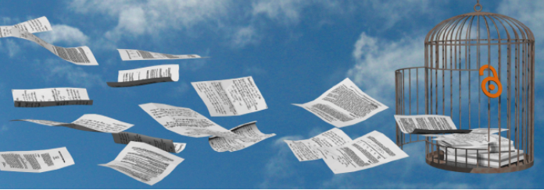
Platform to boost Green Open Access
http://dissem.in
‘Spot your own paywalled papers. Liberate them in one click!’
The platform was created in 2014 by Antonin Delpeuch,
when he was computer science student at ENS Paris,
and is collectively developed in open source by CAPSH (Committee for
the Accessibility of Publications in Sciences and Humanities)

Slide 13
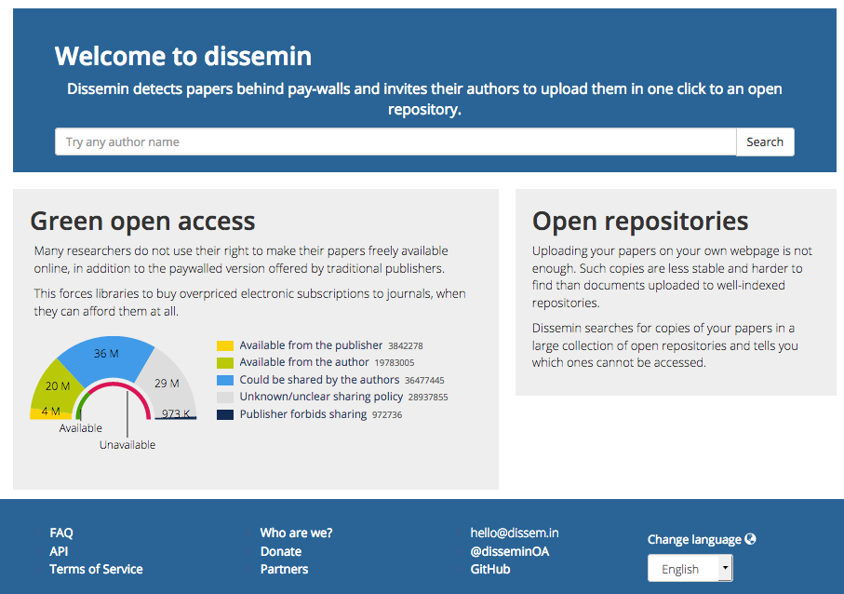
Dissem.in lists the articles of any researcher
Dissem.in crawls
about 90 millions articles

Slide 14
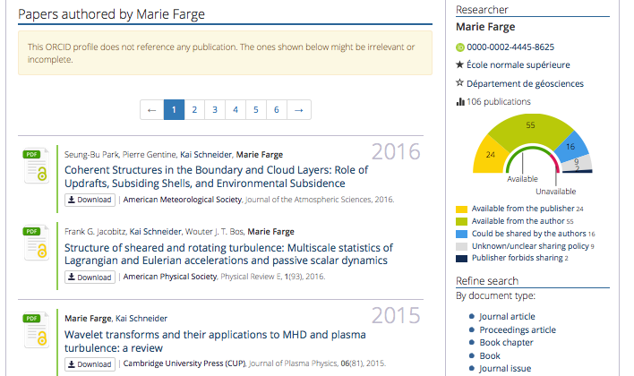
Papers already
in open access
can be downloaded :

Slide 15
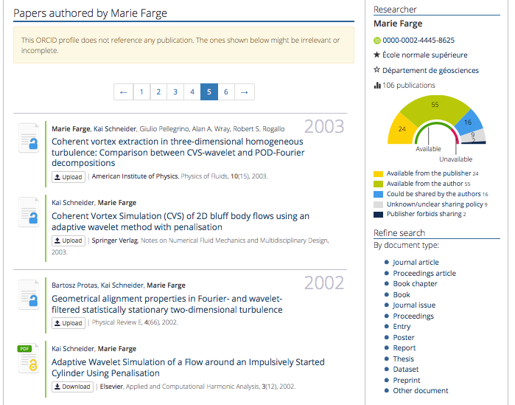
Papers not yet
in open access
can be deposited :

Slide 16
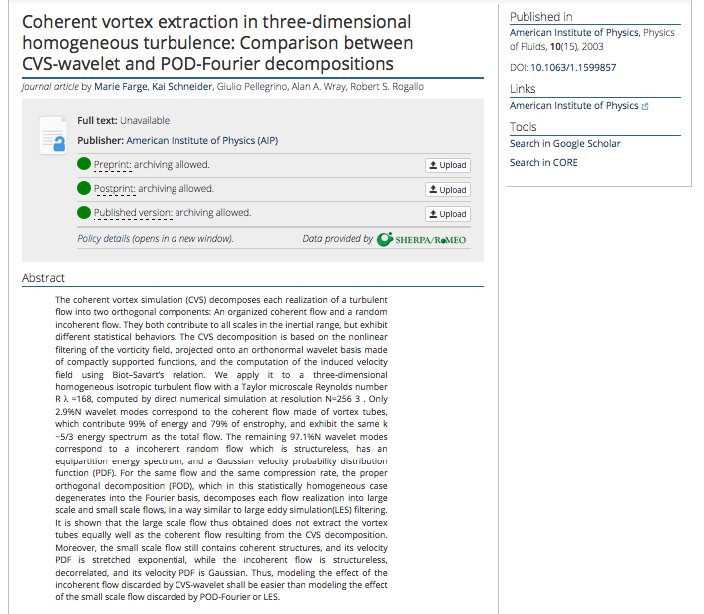
For each article
Dissem.in checks
which version
the publisher
allows to deposit
in open access
and
provides
a very simple way
to deposit it in an
open repository
(e.g., Zenodo, HAL).

Slide 17
Conclusion
Today investments for producing and peer-reviewing articles are public but
ownership of journals, peer-reviewing reports and publishing platforms
and profits from subscriptions, article processing charges
and bibliometric data are private.
Publishers should become service providers to
publicly funded and publicly owned publishing platforms,
without having anymore the property of articles and journals, plus
platforms for peer-reviewing, publishing and computing bibliometry.
Public funding agencies should provide public platforms for
peer-reviewing, publishing and archiving the results of public research.
Intellectual property laws (copyright/authoright) should be improved to
guarantee that results of public research remain public and open.
We need those tools to develop knowlegde as a commons.

Slide 18
What do we need publishers for ?
‘Since the creation of scientific journals 350 years ago, large commercial publishing houses have increased their control of the science system. While one could argue that their role of typesetting, printing, and diffusion were central in the print world, the ease with which these functions can be fulfilled in the electronic world makes one wonder: what do we need publishers for? […] It is up to the scientific community to change the system in a similar fashion and in parallel to the open access and open science movements. Unfortunately, researchers are still dependent on one essentially symbolic function of publishers, which is to allocate academic capital, thereby explaining why the scientific community is so dependent on The Most Profitable Obsolete Technology in History ’
Vincent Larivière et al., The Oligopoly of Academic Publishers, PLOS one, 10th June 2015

Slide 19
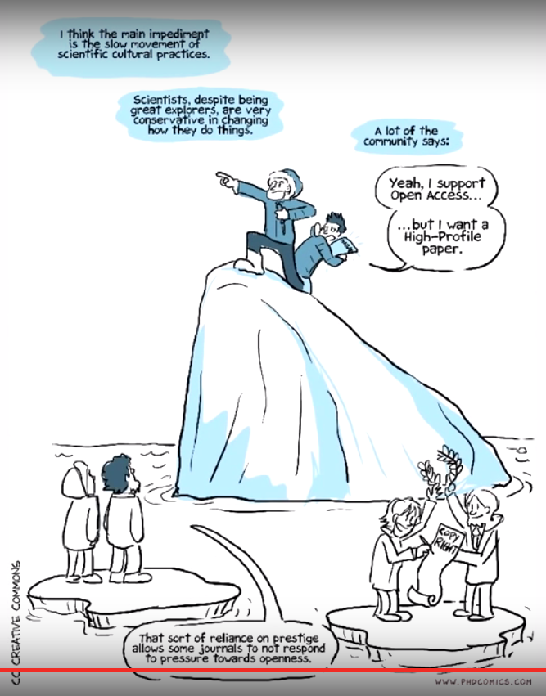
Need to change
present practices
‘Scientists, despite
being great explorers,
are very conservative
in changing how
they do things.’
‘That sort of reliance
on prestige allows
some journals to
not respond to pressure
towards openess.’
What is Open Access?
www.phdcomics.com/TV

Slide 20
'Scholarly publishing and peer-reviewing in open access’, Marie Farge, 2017
in 'Europe’s Future: Open Science, Open Innovation, and Open to the World’, European Commission, DG Research, Science and Innovation, May 2017
‘Consequently to Brexit, the European Commission could reconsider the present negotiation about European copyright law. Indeed, besides United Kingdom, other Commonwealth members and United States of America that are ruled by copyright, most of United Nations members are ruled by author's law. Europe could then play a leading role to promote author's law, to give a better protection to authors and a legal status to knowledge commons.’
Charlotte Hess and Elinor Ostrom,
Understanding knowledge as a Commons,
MIT Press, 2006

Slide 21
Knowledge as a Commons
Ideas are not of the same nature as material products
since when you give an idea, you do not lose it.
Therefore knowledge is not a product to be traded,
but a commons to be shared since
its exchange is a positive-sum game.
Charlotte Hess and Elinor Ostrom,
Understanding knowledge as a Commons,
MIT Press, 2006
Elinor Ostrom received in 2009 the Nobel prize
in economic sciences, together with Oliver Williamson, for :
‘her analysis of economic gouvernance, especially the commons
showing how common resources can be managed successfully
by the people who use them rather than
by governments or private companies’.

Slide 22
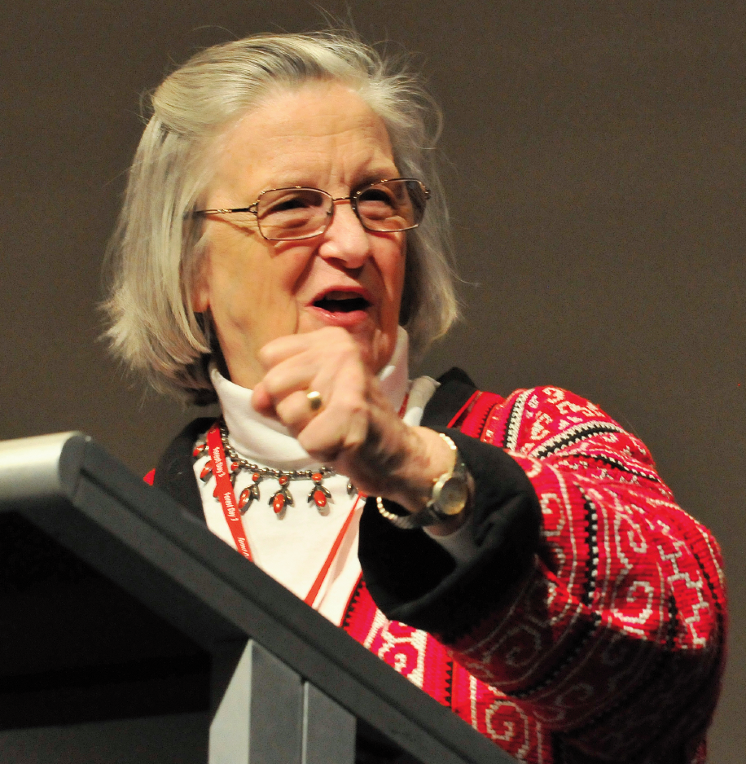
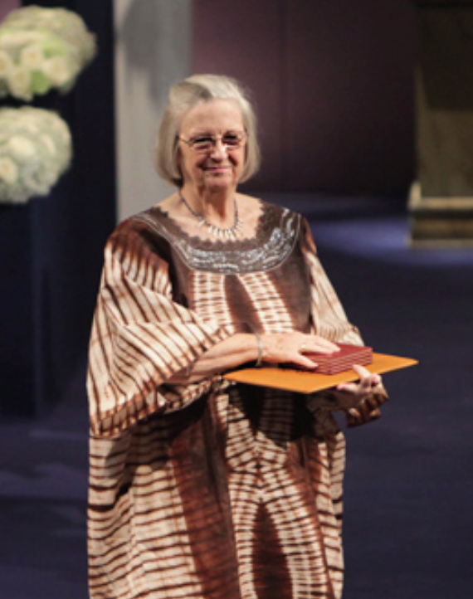
Elinor Ostrom (1933-2012)
She was professor of political science
at Indiana University (USA)
and is the only woman
who has ever received the
Nobel prize in economic sciences.

Slide 23
http://openscience.ens.fr/
http://openscience.ens.fr/MARIE_FARGE/
http://wavelets.ens.fr
'Scholarly publishing and peer-reviewing in open access’, Marie Farge, 2017
in 'Europe’s Future: Open Science, Open Innovation, and Open to the World’, European Commission, DG Research, Science and Innovation, May 2017
http://dissem.in
http://association.dissem.in
https://github.com/dissemin
@disseminOA
Antonin Delpeuch <antonin@delpeuch.eu>
Marie Farge <marie.farge@ens.fr>
Team Dissemin <team@dissem.in>

