Slide 1
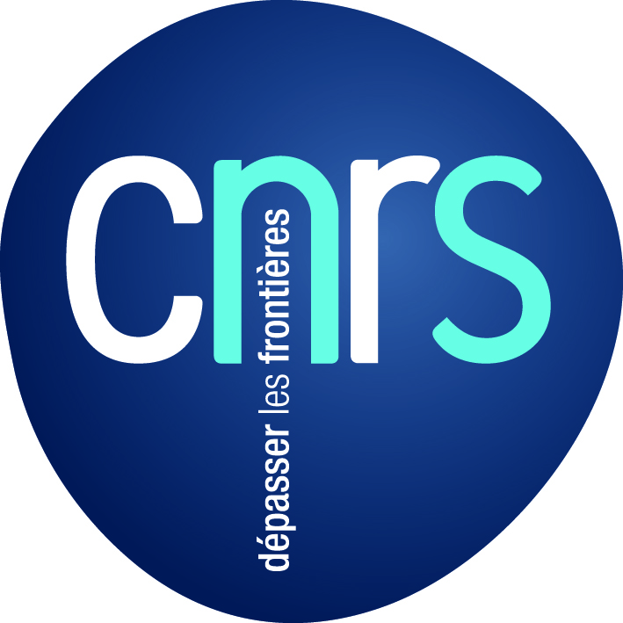
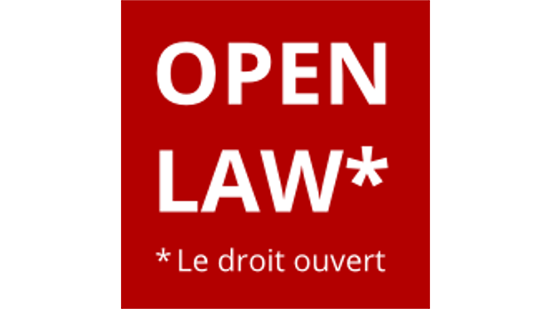
Toward Open Science and Open Doctrine
I. Open Science: from practice to policy Marie Farge II. The Open Doctrine in the French style Jean Gasnault

Slide 2
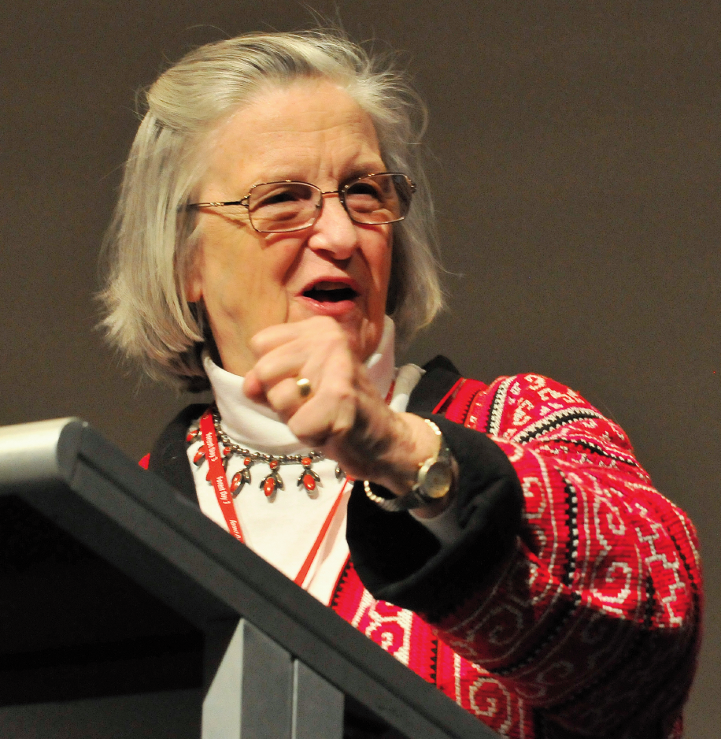
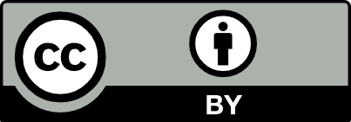
What is Open Science
Ideas are not of the same nature as material products,
since when you give an idea you do not lose it.
Knowledge is not a product to be traded
but a commons to be shared.
Open Science means sharing articles, codes and data.
Charlotte Hess and Elinor Ostrom,
Understanding knowledge as a Commons,
MIT Press, 2006
In 2009 Elinor Ostrom got ½ of the
Nobel prize in economic sciences for
‘her analysis of economic gouvernance,
especially the commons, showing how
common resources can be managed successfully
by the people who use them, rather than
by governments or private companies’.

Slide 3
Researchers design tools for Open Science
In 1978 the computer scientist Donald Knuth (Stanford University) published the Open Software TeX for typesetting research articles,
especially complex mathematical formulae.
In 1990 the physicist and computer scientist Tim Bernes-Lee (CERN) created the Open Protocol http of WWW without patenting it,
in order that it could be adopted by anyone.
In 1991 the physicist Paul Ginsparg (Los Alamos National Laboratory) created the Open Platform ArXiv to share preprints for exact sciences,
the submission rate today is above 10 000 articles/month.
In 1994 the economist Michael Jensen (Harvard University) created the Open Platform SSRN to share preprints for social sciences,
the largest repository in 2013 but Elsevier bought it in 2016.
In 1998 the education scientist John Willinsky (Simon Fraser University) released the Open Software OJS to manage editing and peer-reviewing, used today by about 10 000 of research journals.

Slide 4
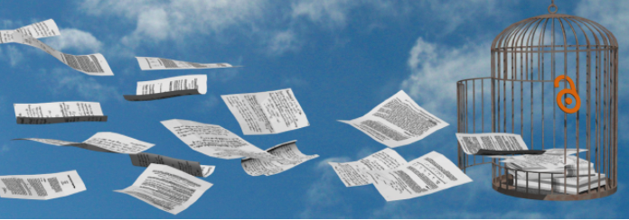
Dissemin, a platform to foster Open Science
In 2014 the computer scientist Antonin Delpeuch,
while he was student at ENS Paris, created the platform http://dissem.in
to help researchers to deposit their articles in open access.
Dissemin is collectively developed in Open Source and
anyone can download it for free from the platform GitHub.

Slide 5
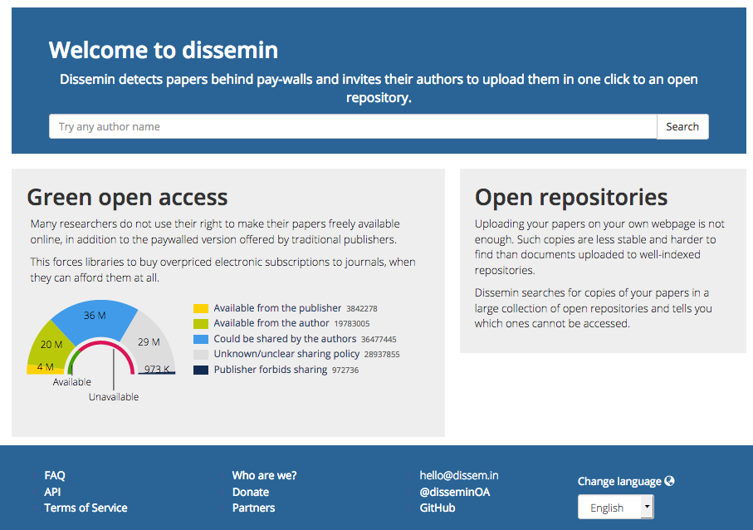
Dissemin lists the articles of any researcher
Type here the first name and family name of a researcher from any discipline
Dissem.in crawls the metadata of
about 100 Millions research articles

Slide 6
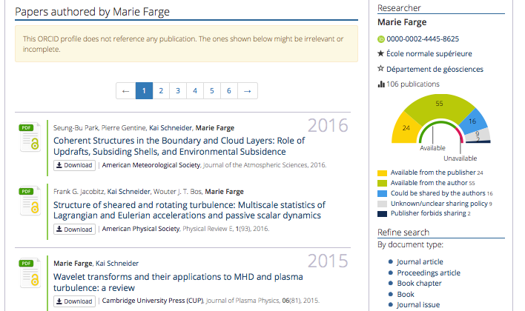
Anyone can download for free any article which is
already in open access, wherever it is stored

Slide 7
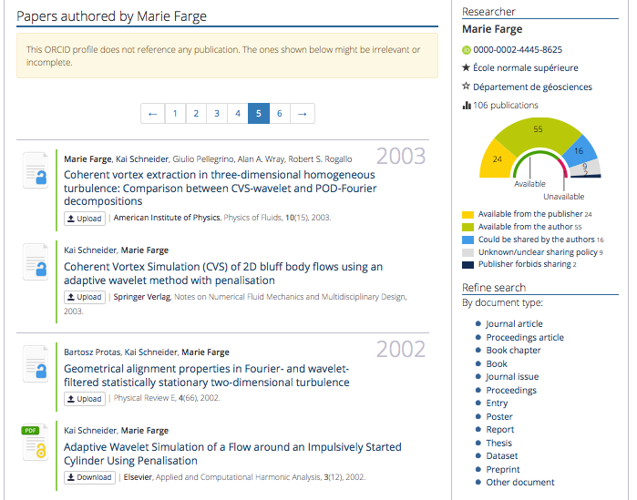
Any author can upload for free his/her articles
which are not yet in open access :

Slide 8
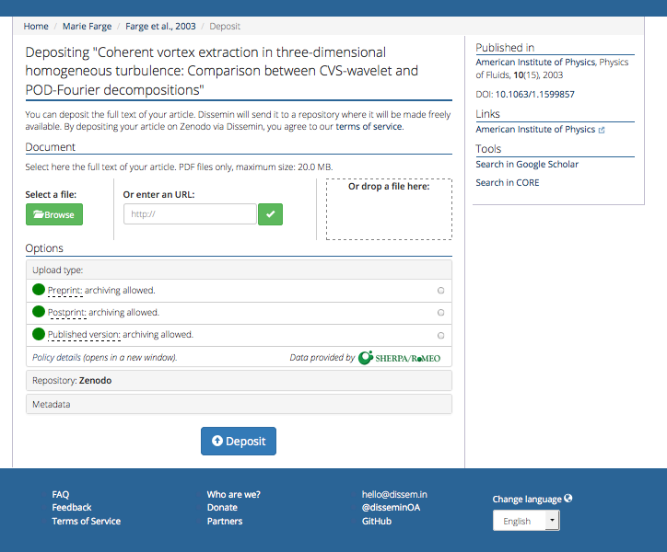
One click
to choose
the version
to deposit

Slide 9
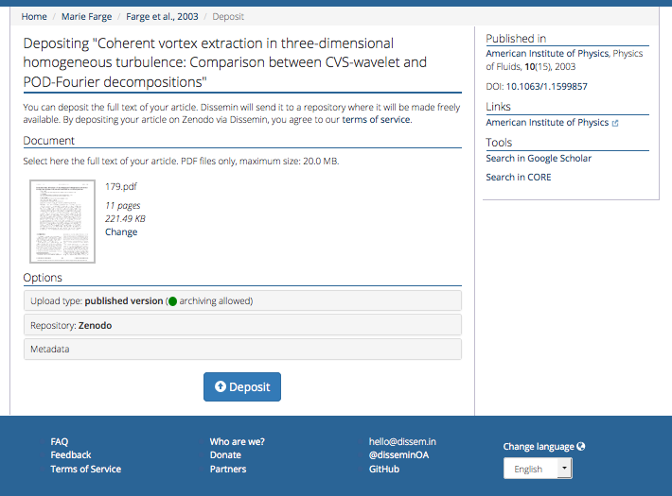
One click
to deposit
in Zenodo
Zenodo is the open repository of CERN.
It accepts any research ouputs from any fields. It is developed in Open Source with the Invenio framework under the licence GNU GPL version 2. It is financed by the European Commission as part
of the European network OpenAIRE.

Slide 10
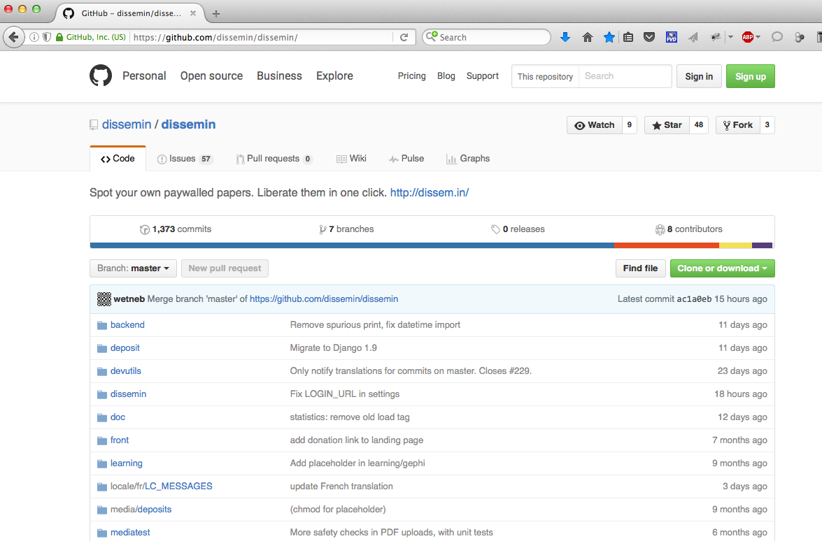
The source of Dissemin is free on GitHub
Dissemin is written in Python and published under the
viral license AFFERO GPL 3, which allows everyone is to use,
modify and distribute its source code, under the condition that
the source of a new version and the source of the platform
to access it are under the same license.

Slide 11
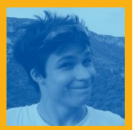
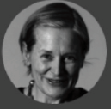
The team CAPSH / Dissemin
Dissemin runs on three rented servers that cost 100 €/month.
It is financed by the non-profit association CAPSH (Committee for the
Accessibility of Publications in Sciences and Humanities) created in 2015
by three computer science students and a mathematician (ENS Paris):
Antonin Delpeuch,
the main developer of Dissemin.
In 2016 he was nominated
Europe’s Open Access Champion by .
Antoine Amarilli
Pablo Rauzy
Marie Farge
Thomas Bourgeat

Slide 12
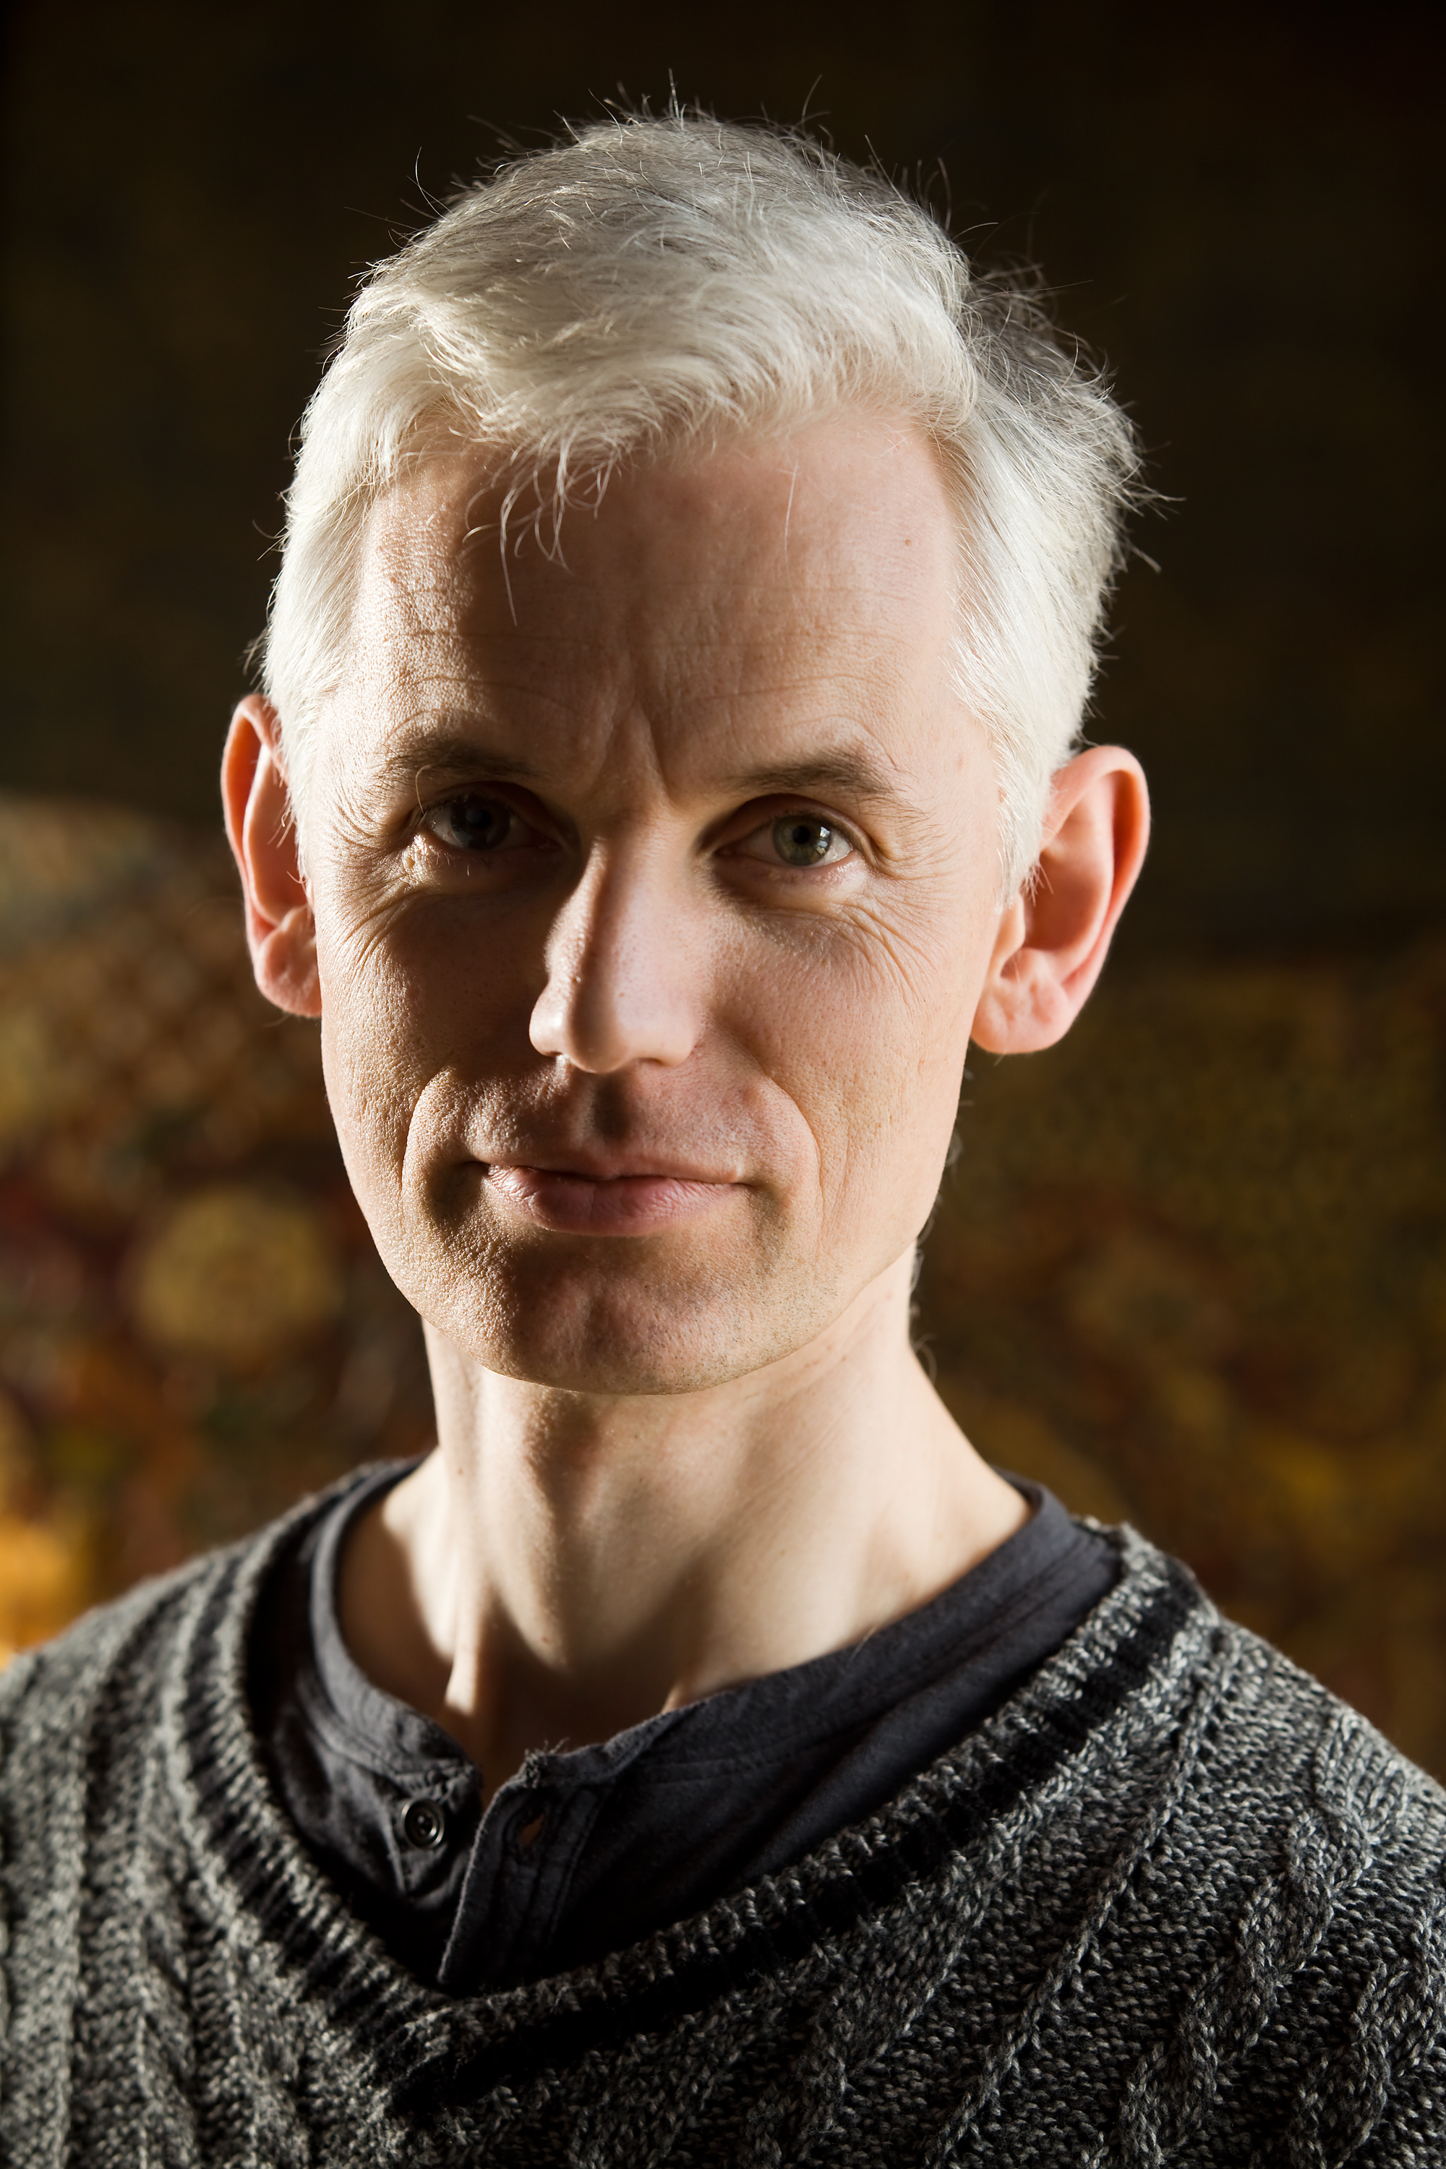
Open Science needs a new policy
In 2012 the mathematician Sir Tim Gowers
called to boycott Elsevier and created COK
( Cost of Knowledge), a group of mathematicians
that stopped the Research Works Act, a bill
proposed to the US Congress due to the
lobbying of Elsevier. COK proposed a new model
for online publishing called ‘Diamond Open Access’:
Neither author nor reader should have to pay to publish online,
Research journals should belong to their editorial boards, which
are in charge of peer-reviewing, but no longer to publishers,
Online peer-reviewing and publishing of research journals should be
done using public infrastructures developed in open source.’
Marie Farge, Note for the French Minister of Research, June 29th 2012
http://openscience.ens.fr/MARIE_FARGE/
https://www.centre-mersenne.org

Slide 13
'Scholarly publishing and peer-reviewing in open access’ by Marie Farge,
in 'Europe’s Future: Open Science, Open Innovation, and Open to the World’, European Commission, DG Research, Science and Innovation, April 2017
http://openscience.ens.fr/MARIE_FARGE
<marie.farge@ens.fr>

Slide 14
The open doctrine in the French style
2nd part
"I've changed, know it, but I'm as I was before" (Barbara, Marienbad)

Slide 15
Introduction
At the crossroads of two universes: exact sciences and human and social sciences
Different university cultures almost opposed to each other
A major change: open science
Common challenges and responses
Find scientific works and harmonize their description
Organize the sharing and the disclosure of this knowledge
The Progress of research necessarily requires sharing - no losses, only gains

Slide 16
Open Doctrine and FALM
Despite longstanding efforts to promote open access to legislation and case law undertaken by the Free Access to Law Movement (FALM), where do things stand in terms of free and open sharing of scientific knowledge?
Open Doctrine is an old issue for the FALM: Declaration on Free Access to Law “Therefore, the legal information institutes agree …/... Academic exchange of research results. » (added to the Paris conference – 2004)
Actors of the FALM involved in the constant growth of open doctrine, examples :
CAnLII's involvement in the development of the CAIJ, (an example of the long-term viability of the freemium model),
presence of the US LII in the Durham statement
Many publications of members of the FALM on open access to the law in the Legal SSRN and DOAJ journals

Slide 17
Legal recognitions
European Union and HCCH recommendations (2012), (annex, art. 1, par. 2) : “State Parties are also encouraged to make available for free access relevant historical materials, including preparatory work and legislation that has been amended or repealed, as well as relevant explanatory materials”
Berlin Declaration on Open Access to Knowledge in the Sciences and Humanities, 2003
Horizon 2020 : Europen Union organisation for Open science
In France, due to successive reforms of doctoral studies, the research world opens up step by step
Last major step : october 2016 law for a digital republic (known as the Lemaire Law)

Slide 18
Art. 30 of the Lemaire Act
Now Article L533-4 of the French Research Code (very simplified version): free access within one year to a scientific article written with public funding
In France, this article marks the first significant victory for digital commons advocates.
unfortunately, not only is this measure poorly enforced, but it has been given very little publicity by the government and none by the operators of the knowledge market.
Despite clear principles, and regulations that strictly apply them, the French implementation of open science remains laborius.

Slide 19
And now ?
Might this be construed as symbolic of open science? One can only hope that the situation will change.
The French government has reiterated its commitment to the expansion of open science in the Etalab action plan for 2018-2020
But on the ground, the situation is more subtle, that's what we're going to see now for Open Science and Open Doctrine.

Slide 20
Law ? A science ?
Open science and law, how many parsecs ? In fact, very near.
Yes, law is a language, yes, it is an art, but it is increasingly confronted with science (statistics, AI, etc.) and is gradually taking on its uses
The approaches of the disciplines (exact sciences and law) are scattered, sometimes in conflict (on principles or technical solutions), but progress in each discipline converges.
"the truth is in the negative of appearances" (Hegel)

Slide 21
Some facets of Open doctrine
Legal Compliance
The technical side
The sociological and cultural aspect
The pedagogical aspect
Economic feasibility
The marketing approach

Slide 22
Legal obligations and practices
Mandatory deposit if publicly funded in a digital directory
Minimum accessibility that opens slowly: university intranet first, then open access and soon translated funds
Various uses for various types of authors and types of works
Lawyers: open access (US Lexology database to the French Wiki GBD)
Doctors of Law: open if everyone agrees, starting with the author
Authors of other research works : according to the need of the moment: to be read absolutely by everyone, to be counted as a research activity, or to remain on good terms with your publisher

Slide 23
Sharing knowledge: a world of apparent paradoxes
Share your knowledge or make a career? How about both?
Between researchers and French academic bodies or outside France and outside its native language?
Law French researchers probably do not need the SETHI program to understand that they are not alone in thinking about law in the Universe, or even on Earth

Slide 24
Pedagogies
Encourage to describe and then share your work
The virtuous action of documentation centres
Awareness of the teaching world
Doctoral school recommendations
And their inevitable administrative corollaries (avoid complicating the filing, and threatening authors)
E-learning supports, MOOC are multiplying and their authors are finally talking to each other
Human support is essential to convince, train and help

Slide 25
From the descriptive sheet to the meta-data
Minimum principle: all research work must be described - metadata must be freely accessible, and the public physical location of the work must be known to all
Practical implementation: various platforms have emerged: local and national - national institutions in charge of scientific and technological information and the management authorities of researchers have begun to work together to put some order into the situation.
An unavoidable necessity: the harmonization of the metadata structure (starting from the Dublin Core as a minimum to be guaranteed) in accordance with international standards

Slide 26
Full text open access ? Golden Way ?
The various actors do not have the same visibility needs, some must show all their work, others can limit their consultation to a small committee of readers
Should everyone have free access to all the necessary legal knowledge?
The impact on the economic model of this envisaged progress must be measured. Free access release of documents that no longer sell at all is beginning to be practiced.
Discussing with the market is now essential, knowing that all the solutions found will be scalable in essence, drawing inspiration from solutions found outside of France
Better inform French actors about the foreign practice of disseminating Legal Doctrine: EU policy, North American practices, emerging countries

Slide 27
Open Thesis Award : a quick summary
Audience: any doctor of law who defended his thesis between January 1, 2016, and December 31, 2018, and who submitted it freely in the HAL directory with the authorization of his jury, respecting the ABES referencing standards
Calendar: end of 2018 writing of the official competition rules and recruitment of the jury, opening at the beginning of 2019, the proclamation of the prize at the Village de la Legal Tech at the end of 2019 (meeting co-organized by Open Law every year)
Purpose: to reward positive actors, to motivate doctors of law to open access to the full text of their thesis in a public digital archive and to use the event to promote an open international common fund of legal knowledge
Reward: a support to the publication on paper, associated with a very wide diffusion of this thesis on the Internet

Slide 28
Conclusion
Opening Doctrine in France is a very long way trip.
Start since the beginnings of the Internet (1995)
Very slow progress
Multiple attempts and many failures
Mistrust and constant fear of the university community
But, but, but …
Times are changing, now!

