Slide 1
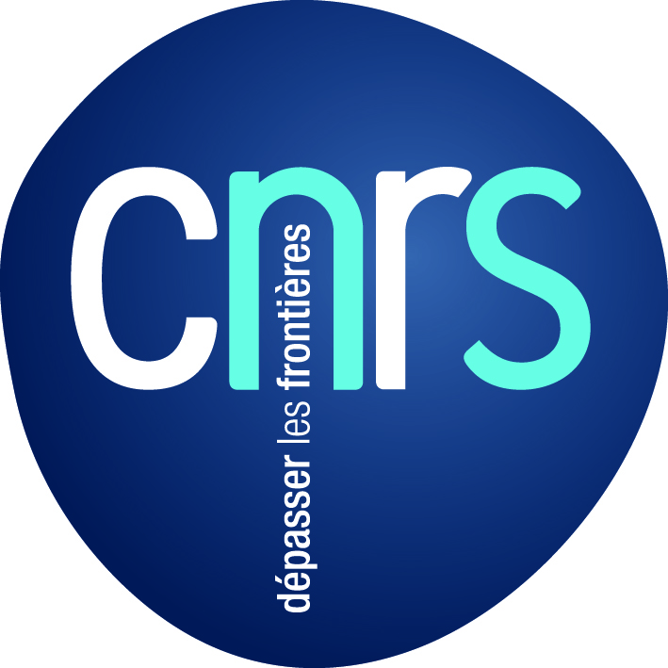
The Diamond Open Access :
a model for researchers and funding agencies
to recover control of their articles and journals
Marie Farge
CNRS-INSMI and ENS Paris
June 28th 2022
Insitute of Mathematics,
Universität Potsdam

Slide 2
Who has access to research articles?
Only researchers working in institutions rich enough
to pay the very costly journals they need!
Researchers working in enterprises, or in poor countries,
teachers, students, retired researchers and citizens who finance
public research do not have access to most of the research articles.
Most of the research journals have been bought by
few major publishers, whose exhorbitant profits rely on the work
that researchers and their funding agencies offer them for free.
Today, publishers benefit from the digital revolution and the Web to
reduce production costs using online peer-reviewing and publishing,
but keep the business model designed for printing on paper.
Major publishers have acquired an oligopolistic position!

Slide 3
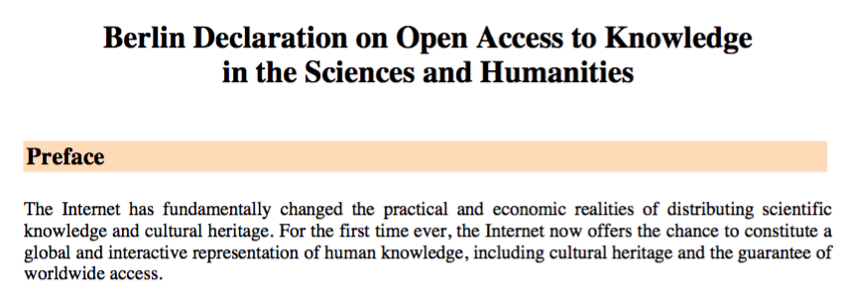
2003, the Berlin Declaration

Slide 4
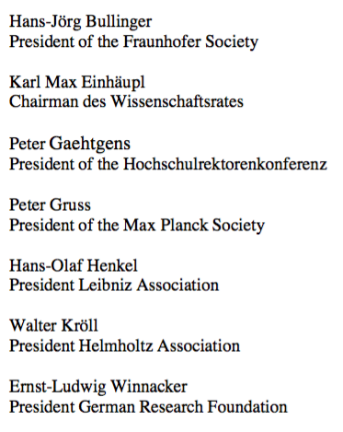
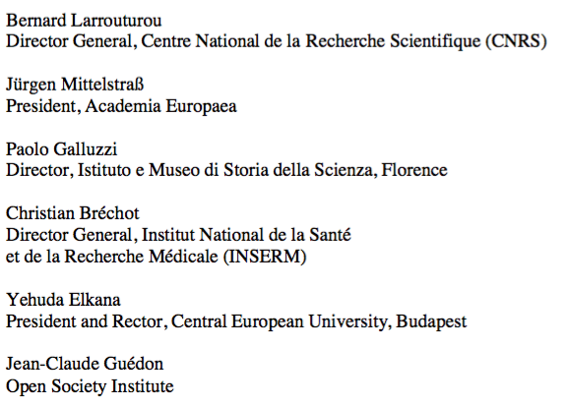
22nd October 2003, signatories

Slide 5
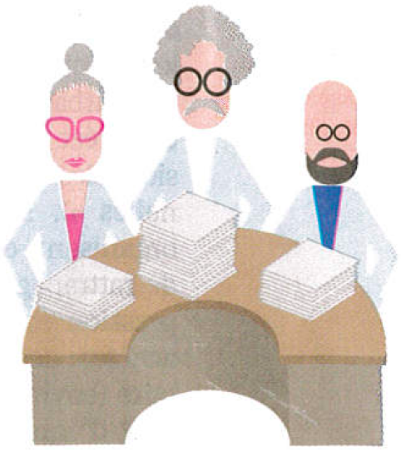
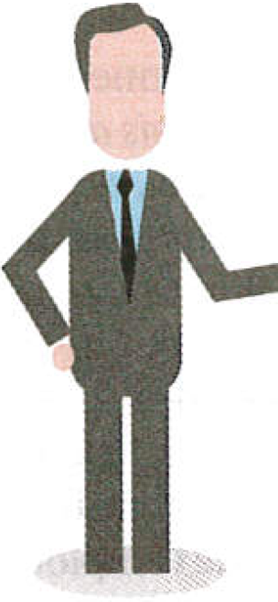
The business model of publishers
Researchers write articles,
typeset them ‘camera ready’,
review those of their peers
and are editors of journals.
Taxpayers
After articles are accepted
by reviewers and editors,
publishers ask authors to give them their copyright for free.
Journals are sold by subscription.
Articles are in open access if authors pay them Article Processing Charges.
Researchers
acting as editors
and referees for free
Their salaries
are paid
by taxpayers
Librarians negociate subscription contracts with publishers (increasingly with prepaid APCs), pay for them,
control access to articles and curate the collections.
Publishers
make huge
profits

Slide 6
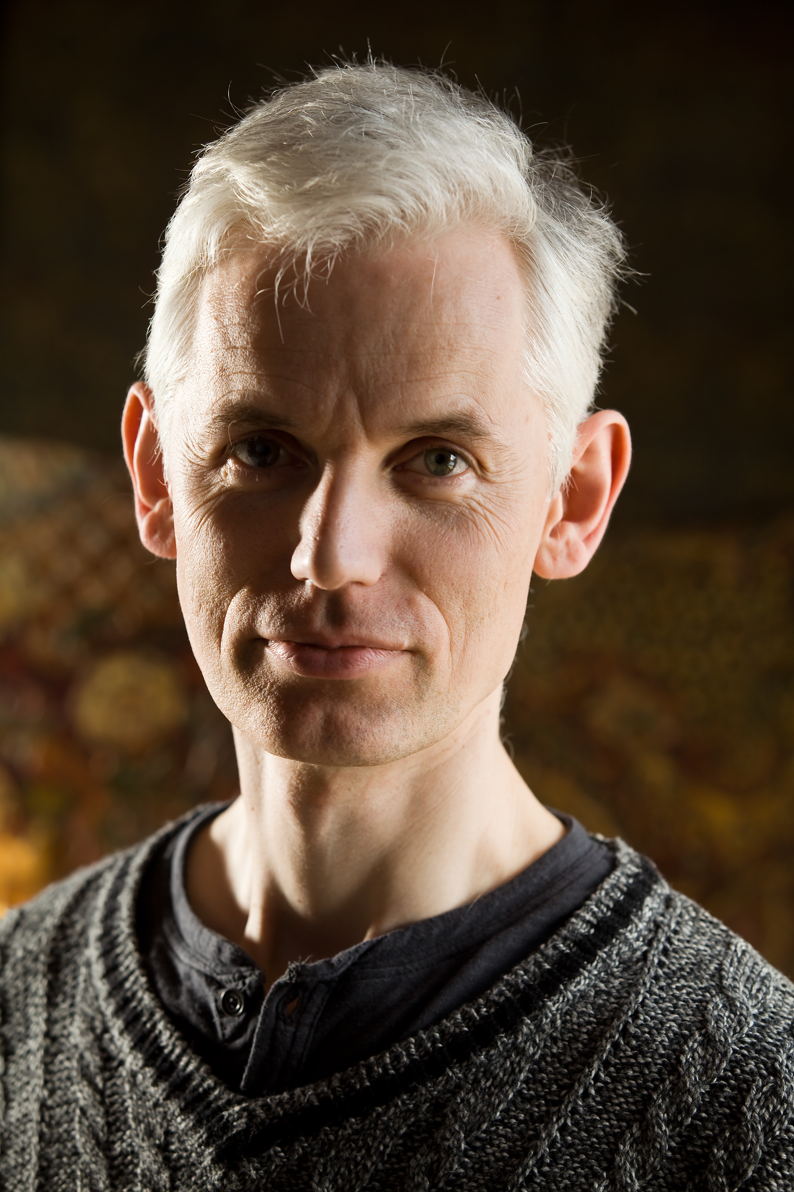
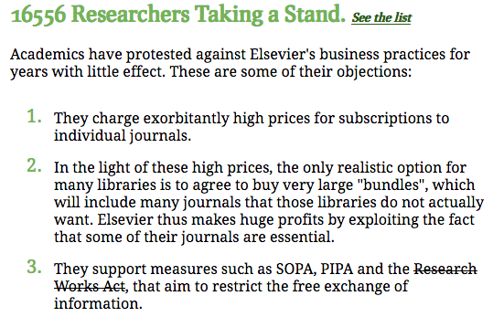
2012, the ‘Cost of Knowledge’ revolt
In 2012 Tim Gowers and 33 mathematicians called for a boycott of Elsevier.
They succeeded in stopping the Research Works Act, a bill introduced in the U.S. Congress as a result of Elsevier‘s lobbying to control open access.
Sir Tim Gowers,
Cambridge University,
Fields medal 1998
http://www.thecostofknowledge.com

Slide 7
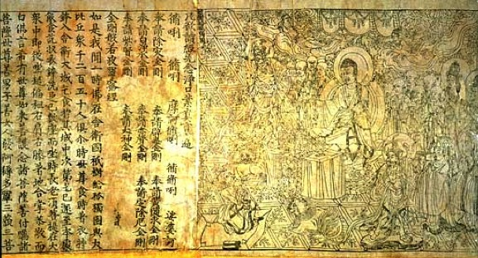
The ‘Cost of Knowledge’ proposition
`Neither author nor reader should have to pay to publish and
a journal should no more belong to a publisher but to its editorial board.
Peer-reviewing and publishing are done using public infrastructures
where articles are archived and accessible online for free.’
M. F., Note for Geneviève Fioraso, French Minister of Research, June 29th 2012, http://openscience.ens.fr/MARIE_FARGE/
I suggested calling this model
‘Diamond OA’ to outbid the
publishers’ Gold OA model.
Diamond Sutra, the earliest printed book,
China, 11th May 868
British Library

Slide 8
The Diamond Open Access model
1
Authors keep their copyright and allow
their articles to be published in Open Access
Under the Creative Commons license CC-BY.
https://creativecommons.org/licenses/
2
Editors of a peer-reviewed journal collectively own its title and assets,
since they are in charge of peer-reviewing the submitted articles.
Editors and referees peer-review for free, as their academic duty.
3
Publishers no more own journals
but could provide services to editors
who select them on a competitive basis.

Slide 9
Researchers need publishing platforms
Funding agencies should provide for free to researchers
publicly-owned platforms, developed using open source software,
for peer-reviewing, publishing and archiving articles, data and codes,
with the help of librarians, and of publishers as subcontractors.
Anyone worlwide would have free access (i.e., open and gratis)
to peer-reviewed publications (e.g., articles, data, codes, videos)
without researchers have to pay and give their copyrights.
Publishing platforms would also control the quality of peer-reviewing,
by selecting the journals having good practices and reputable editors.
They would thus provide tools to researchers to experiment new ways
of publishing their research outputs (e.g., open peer-reviewing).

Slide 10
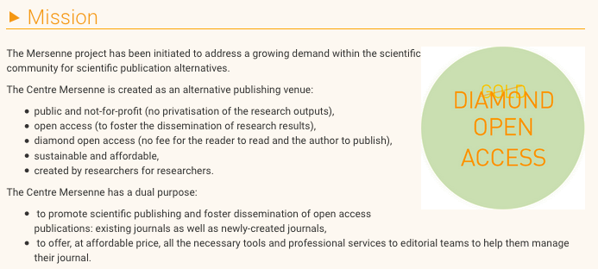
2017, Mersenne Diamond OA Platform
https://www.centre-mersenne.org

Slide 11
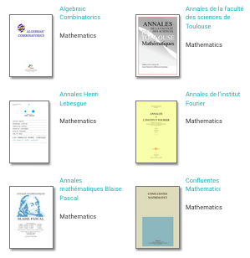
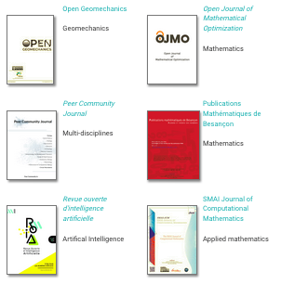
Mersenne Diamond OA Platform

Slide 12
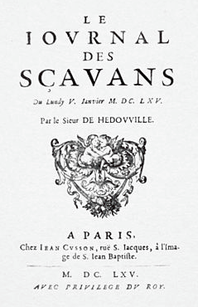
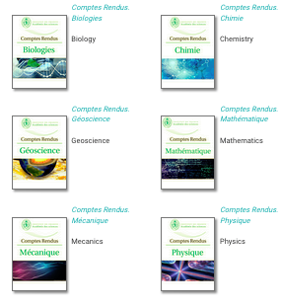
2020, Comptes-Rendus Acad. Sci. Paris
In 1665 Denis de Sallo
created the
‘Journal des Sçavans’.
In 1835 the astronomer
François Arago
created the CRAS.
They were published
by Gauthier-Villars,
bought by Elsevier in 2000.
5th January 1665
`It would be an excellent advertisement
for the ‘Académie des Sciences de Paris’
if its ‘Comptes-Rendus’ (CRAS) were
published using the ‘Diamond OA’ model.’
M. F., Note for Geneviève Fioraso, June 29th 2012
Since 2020, the CRAS are no longer
published in Gold Open Access by Elsevier
but in Diamond OA by Mersenne.

Slide 13
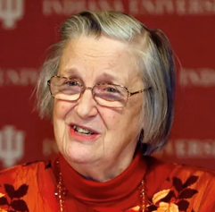
Scientific Objective Reproducible Open
Ideas are not of the same nature as material products,
since when you give an idea you do not lose it.
Therefore knowledge is not a product to be traded,
but a commons to be shared.
Sharing ideas is a positive-sum game.
In 2009 Elinor Ostrom got the
Nobel prize in economic sciences for:
`her analysis of economic gouvernance,
especially the commons, showing how
common resources can be managed successfully
by the people who use them, rather than
by governments or private companies’.
Charlotte Hess and Elinor Ostrom,
Understanding knowledge as a Commons,
MIT Press, 2006

Slide 14
Summary
Today investments, for producing and peer-reviewing articles,
are public but ownership of journals, peer-reviewing reports,
platforms (for peer-reviewing, publishing, bibliometry)
and profits (from subscriptions, APCs and data) are private.
Publishers should become service providers to
publicly funded and publicly owned publishing platforms,
without owning anymore articles, journals, platforms
(for peer-reviewing, publishing, bibliometry) and data.
Funding agencies should provide public platforms to researchers
for peer-reviewing, publishing and archiving research outputs.
Intellectual property laws (copyright/copyleft) should be improved to
guarantee that research outputs remain public and open.
We need those tools to develop knowlegde as a commons.

Slide 15
http://openscience.ens.fr/MARIE_FARGE
http://wavelets.ens.fr
<marie.farge@ens.fr>
'Scholarly publishing and peer-reviewing in open access’, Marie Farge,
in 'Europe’s Future: Open Science, Open Innovation, and Open to the World’, European Commission, DG Research, Science and Innovation, April 2017
http://dissem.in
http://association.dissem.in
https://github.com/dissemin

Slide 16
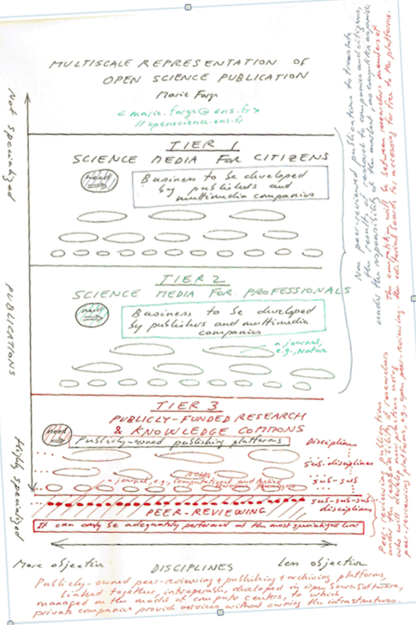
Level of popularization
Diagram for Carlos Moedas, 2016
Popularization
of science
for citizens
For profit
playground of
commercial
publishers
Scientific
information for
professionals
Peer-reviewed
articles for
researchers
Non for profit
knowledge
commons
Level of specialization
Disciplinary bibliodiversity

