Slide 1
How can researchers regain control
of their publications, improve their quality
and disseminate them to all ?
Marie Farge
CNRS-INSMI, ENS Paris and CAPSH
October 16th 2022
BRCP Annual Conference,
Wien Universität

Slide 2
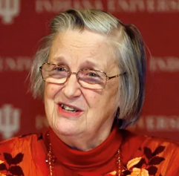
Principle
Ideas are not of the same nature as material products,
since when you give an idea you do not lose it.
Therefore knowledge is not a product to be traded,
but a commons to be shared.
If not shared, an idea is lost forever !
Sharing ideas is a positive-sum game.
In 2009 Elinor Ostrom got the
Nobel prize in economic sciences for:
`her analysis of economic gouvernance,
especially the commons, showing how
common resources can be managed successfully
by the people who use them, rather than
by governments or private companies’.
Charlotte Hess and Elinor Ostrom,
Understanding knowledge as a Commons,
MIT Press, 2006

Slide 3
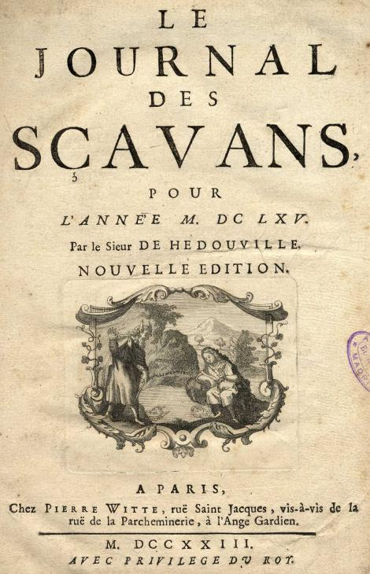
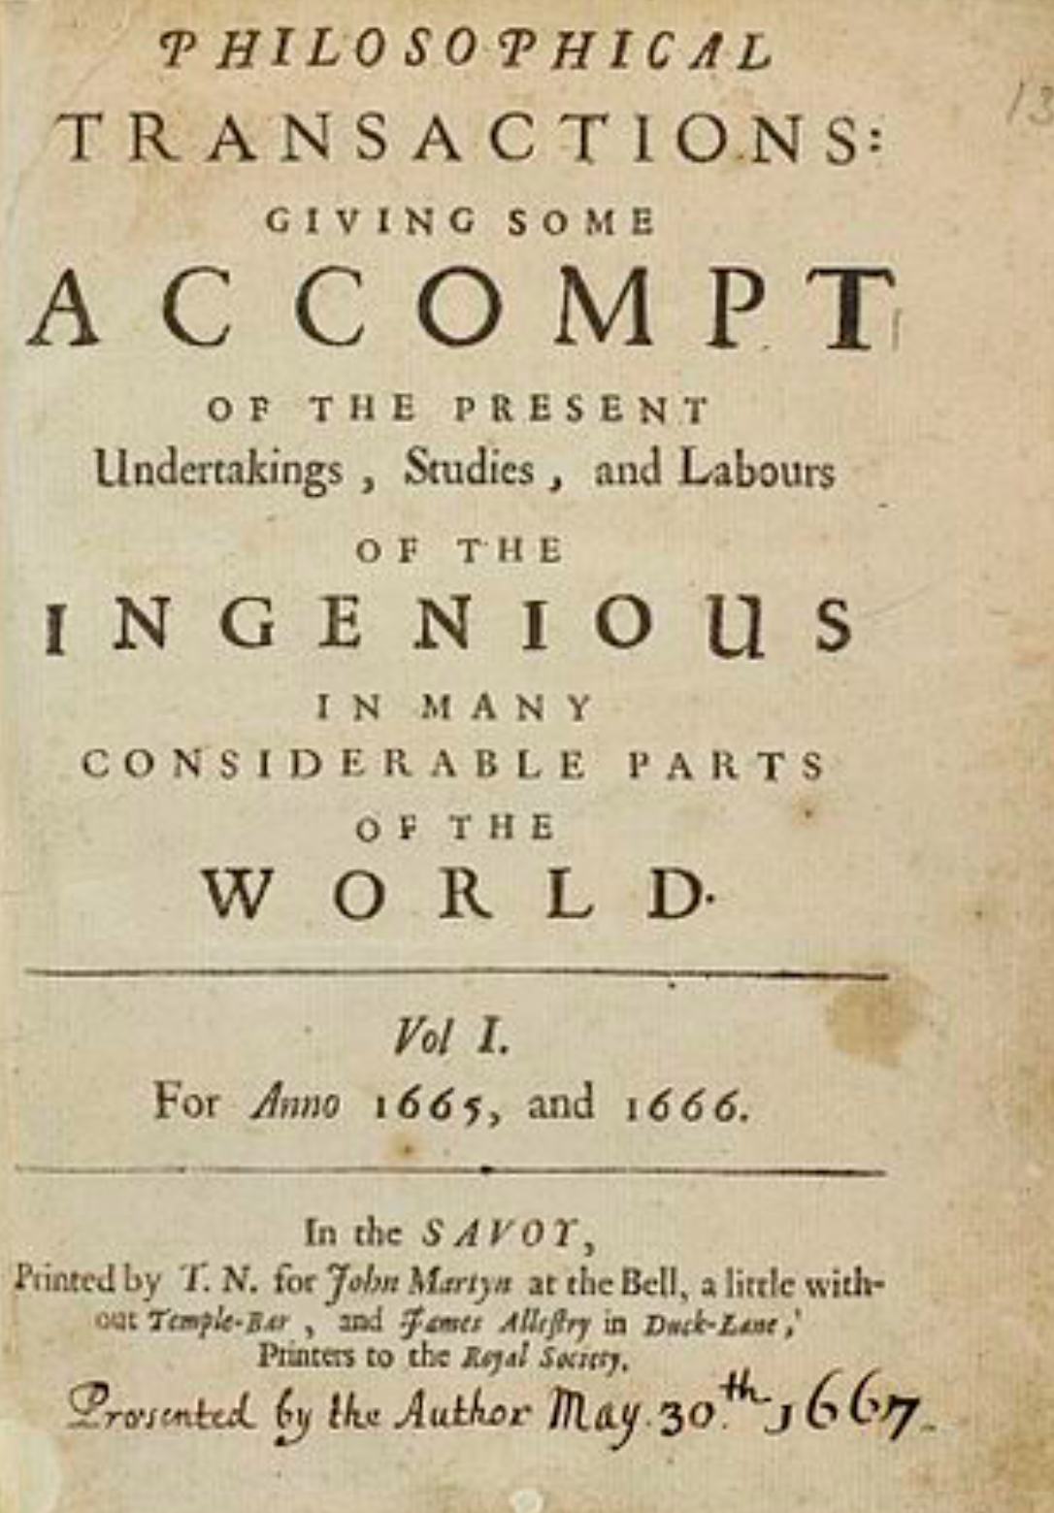
Researchers created their own journals
Paris, January 5th 1665
London, March 6th 1665

Slide 4
Researchers designed their own tools
In 1978, the computer scientist Donald Knuth (Stanford University)
published the Open Software TeX for typesetting research articles,
in particular for mathematical formulas.
In 1990, the physicist and computer scientist Tim Bernes-Lee (CERN)
created the Open Protocol http of WWW without patenting it
in order that it could be adopted by anyone.
In 1991, the physicist Paul Ginsparg (Los Alamos National Laboratory)
created the Open Platform ArXiv to share preprints for exact sciences,
the submission rate today is above 10 000 articles/month.
In 1994, the economist Michael Jensen (Harvard University)
created the Open Platform SSRN to share preprints for social sciences,
the largest repository in 2013 but Elsevier bought it in 2016.
In 1998, the education scientist John Willinsky (Simon Fraser University)
released the Open Software OJS to manage editing and peer-reviewing,
used today by more than 10 000 research journals.

Slide 5
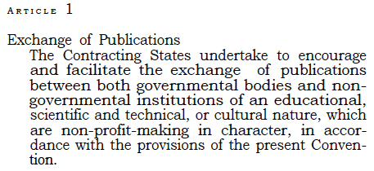
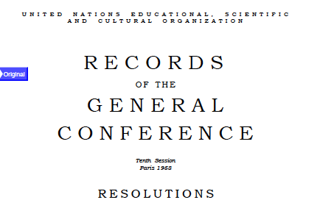
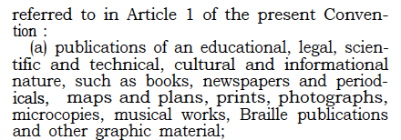
1958, UNESCO declaration
At its 1958 Annual Meeting, UNESCO pledged to promote the exchange of scientific publications
on a free and non-commercial basis.
http://openscience.ens.fr/
ABOUT_OPEN_ACCES/
DECLARATIONS

Slide 6
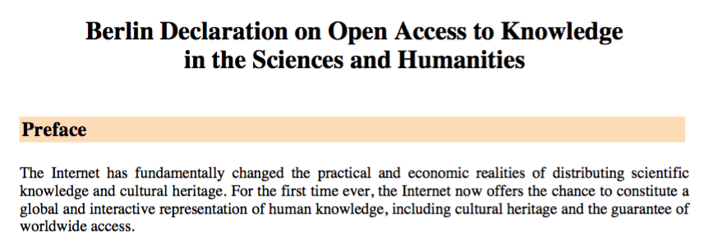
2003, Berlin declaration
http://openscience.ens.fr/ABOUT_OPEN_ACCESS/DECLARATIONS/

Slide 7
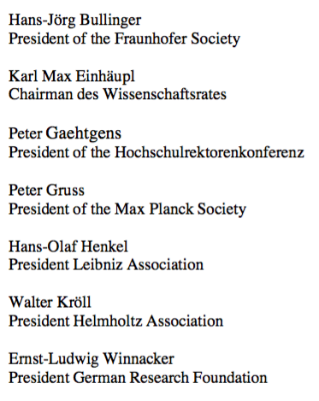
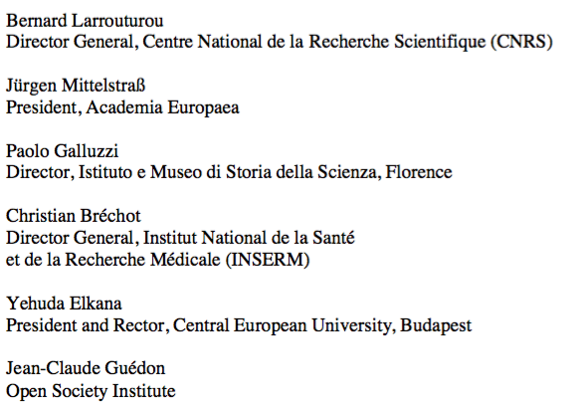
2003, research organisations signed it

Slide 8
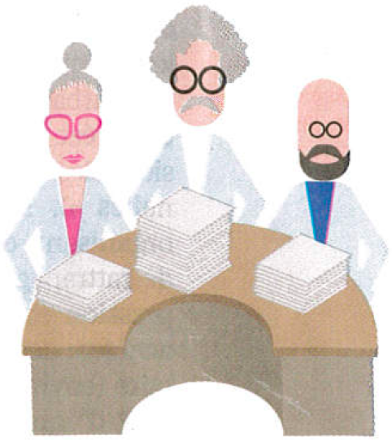
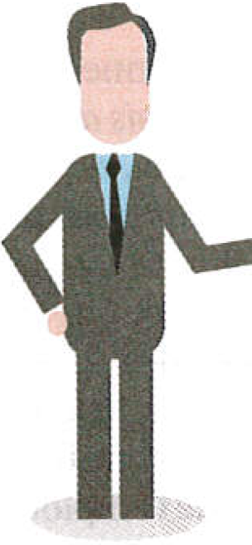
Today, the business model of publishers
Taxpayers
Researchers write articles,
typeset them ‘camera ready’,
review those of their peers
and are editors of journals.
Researchers
work as editors
and referees for free
After articles are accepted
by reviewers and editors,
publishers ask authors to give them
their copyright for free!
Journals are sold by subscription and
articles are in open access only if authors pay Article Processing Charges (APCs).
Researchers
and librarians
are paid
by taxpayers
Librarians negociate bundled contracts with publishers
for subscriptions and prepaid APCs, pay for them,
control access to articles and curate collections.
Publishers
make huge
profits

Slide 9
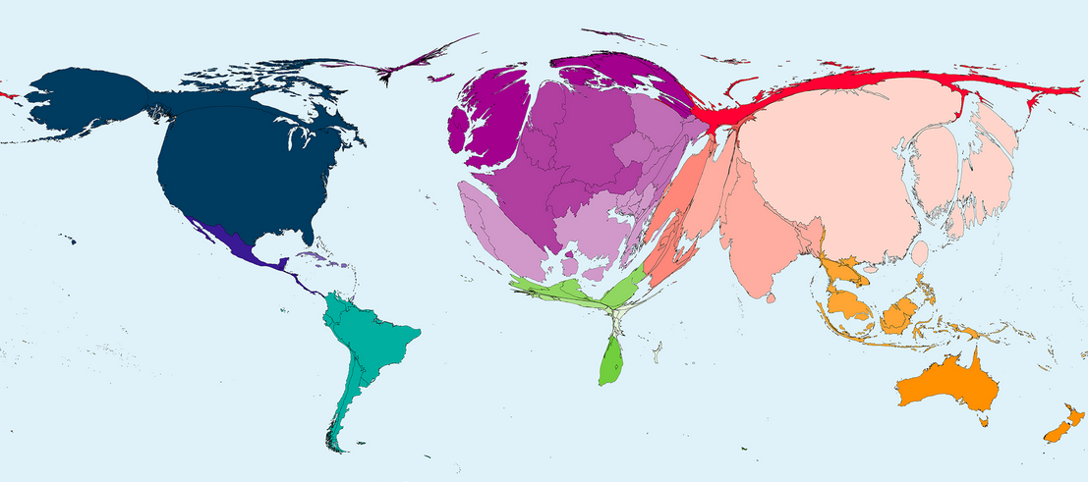
Gold Open Access is counter-productive
Number of research articles published in 2016 divided by the number of inhabitants per country
http://www.worldmapper.org
Publishers impose the Gold Open Access model, which flips subscription
into Article Publication Charges (APCs) one has to pay to publish.
research institutions will get bankrupted or stop publishing!

Slide 10
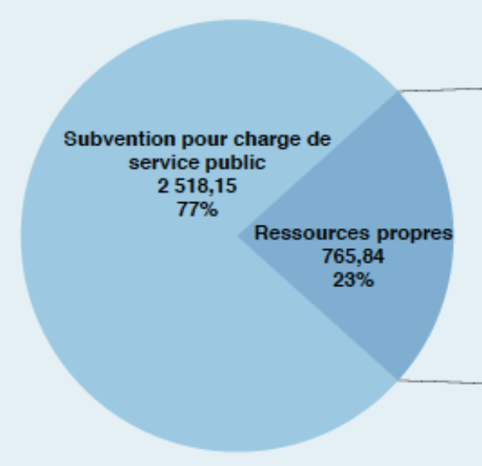
The oligopoly of academic publishers
Four private commercial companies
control academic publishing :
Elsevier (REED), Springer Nature,
Wiley-Blackwell and Taylor&Francis (Informa).
>>
8.4 Billions €
turnover of Reed-Elsevier (RELX)
in 2017
3.3 Billions €
budget of CNRS
in 2017
http://www.elsevier.com
http://www.cnrs.fr/fr/le-cnrs

Slide 11
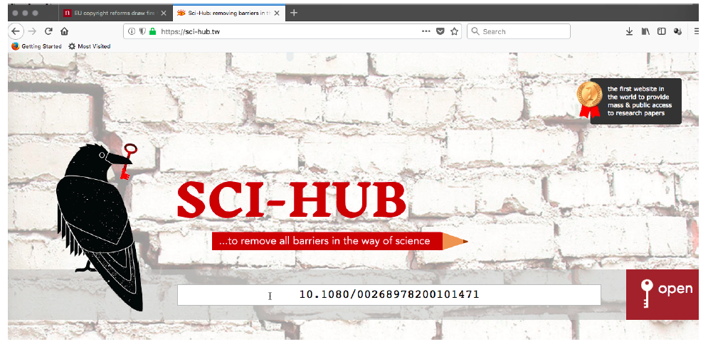
2011, a revolutionary platform
Allez sur le site où l’article est bloqué par un péage,
recopiez son DOI (Digital Object Identifier),
puis aller sur Sci-Hub et entrez son DOI
http://openscience.ens.fr/OTHER/SCIHUB/

Slide 12
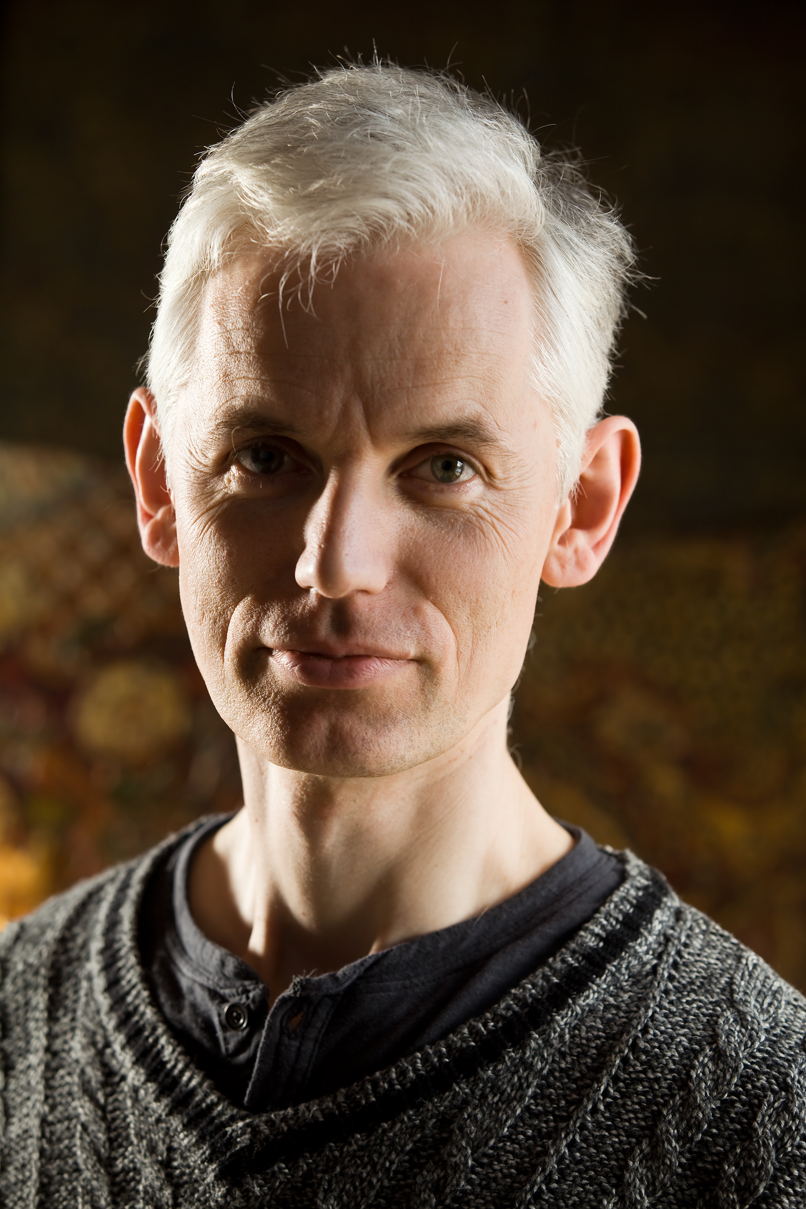
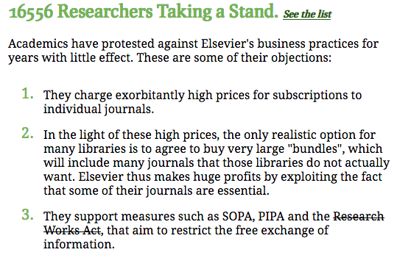
2012, the ‘Cost of Knowledge’ revolt
In 2012 Tim Gowers and 33 mathematicians called for a boycott of Elsevier.
They succeeded in stopping the Research Works Act, a bill introduced in the
U.S. Congress due to Elsevier‘s lobbying to control open access.
Sir Tim Gowers,
Cambridge University,
Fields medal 1998
http://www.thecostofknowledge.com

Slide 13
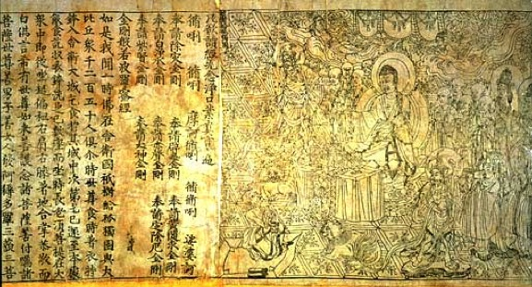
2012, researchers proposed Diamond OA
`Neither author nor reader should have to pay to publish and
a journal should no more belong to a publisher but to its editorial board.
Peer-reviewing and publishing are done using public infrastructures
where articles are archived and accessible online for free.’
June 29th 2012, Marie Farge, Note for Geneviève Fioraso, French Minister of Research,
http://openscience.ens.fr/MARIE_FARGE/
Inspired by the Diamond Sutra
printed in China in 868,
I proposed calling this model
Diamond OA to outbid the
publishers’ Gold OA model.
Wikipedia, Diamond Sutra
Wikipedia, Diamond Open Access
Diamond Sutra, the oldest dated printed book,
China, 11th May 868
British Library

Slide 14
The Diamond Open Access model
1.
Peer review and publication are done
without authors and readers having to pay.
Authors retain their copyright and before submitting their article to a journal
they depose it with a CC-BY license, which allows anyone to publish it
as long as the authors are credited as the copyright holders
2.
https://creativecommons.org/licenses/
Their article is officially dated and in open access for free.
.
Editors collectively own the title and assets of academic journals,
as they are responsible of the peer review of submitted articles.
Editors and referees peer review free of charge as part of their academic duty.
3.
Publishers no longer own academic journals but can continue
to provide services to journal editors, who have regained the power to
choose on a competitive basis the publishers they prefer.

Slide 15
Researchers ask for publishing platforms
Funding agencies should provide for free to researchers
non-profit platforms, developed using open source softwares,
to peer review and disseminate their publications to all,
with the help of librarians and publishers as contractors.
Everyone in the world would have free access (i.e., open and gratis)
to peer-reviewed publications (e.g., articles, data, codes, videos, etc.)
without researchers having to pay or give their copyrights.
The scientific committees of publishing platforms would also
control the quality of peer review by selecting journals
with good practices and reputable editors with limited mandates.
This would provide researchers tools to experiment new ways
of publishing their results (e.g., open peer review).

Slide 16
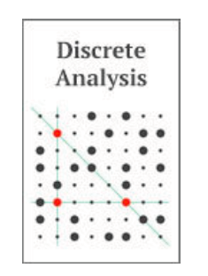
2010, Diamond OA journals
1
//www.ipol.im ISSN : 2105-1232 DOI : 10.5201/ipol
Founded in 2010 by Jean-Michel Morel, IPOL has 41 editors.
It is financed by CNES, ERC and 13 public institutions from 5 countries.
Each article contains the text, the algorithm and the source code,
which all are peer reviewed. The journal platform also provides
online demonstration facility and an archive of experiments.
IPOL thus ensures open science and reproducible research.
2
http://discreteanalysisjournal.com ISSN : 2397-3129
Founded in 2015 by Tim Gowers, DA has 12 editors.
It is an overlay journal on the open repository arXiv.
It is financed by Cambridge University (10$/submission).

Slide 17
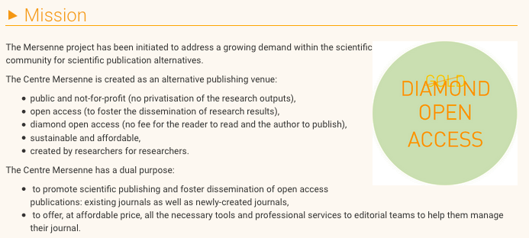
2017, Diamond OA platform Mersenne
The production cost is on average 700 € per article and 35 €/pages,
which is financed by French public research funding institutions :
https://www.centre-mersenne.org

Slide 18
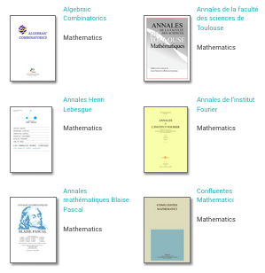
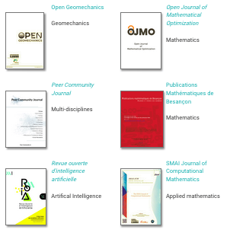
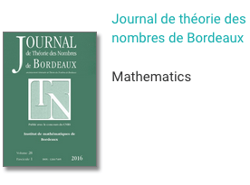
Journals published by Mersenne
Mersenne also publish other journals (e.g., CRAS and Peer Community Journal)
together with conference proceedings, seminars and books.

Slide 19
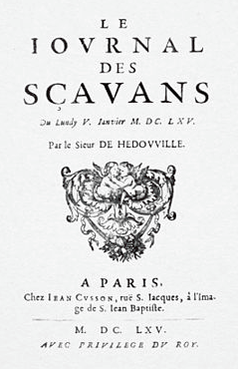
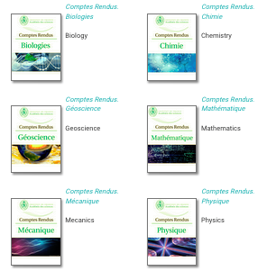
Comptes-Rendus Acad. Sci. Paris
In 1665, creation of the
`Journal des Sçavans’.
In 1835, it became the
`Comptes-Rendus de
l’Académie des Sciences’
(CRAS), which were published
by Gauthier-Villars.
In 2000, Elsevier bought
Gauthier-Villars.
5th January 1665
`It would be an excellent advertisement
for the ‘Académie des Sciences de Paris’
if its ‘Comptes-Rendus’ were published
using the ‘Diamond OA’ model.’
Marie Farge, Note for Geneviève Fioraso, 2012
.
Since 2020, CRAS are published,
no longer in Gold Open Access by Elsevier,
but in Diamond OA by the platform Mersenne.

Slide 20
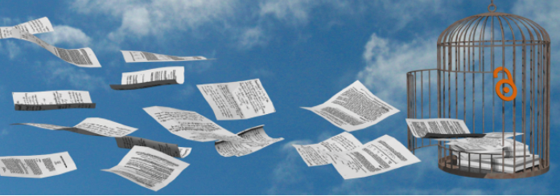
2014, Dissemin to boost Green OA
In September 2014 Antonin Delpeuch
created the platform http://dissem.in
which is collectively developed in open source.
‘Spot your own paywalled papers.
Liberate them in one click!’

Slide 21
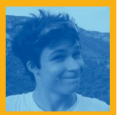
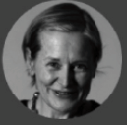
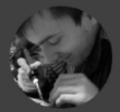
The team CAPSH / Dissemin
http://dissem.in is supported by the non profit association CAPSH
(Committee for the Accessibility of Publications in Sciences and Humanities)
created on September 5th 2015 by :
Creator and main developer
of the platform Dissemin
2016
Antoine Amarilli
Pablo Rauzy
Marie Farge
Thomas Bourgeat

Slide 22
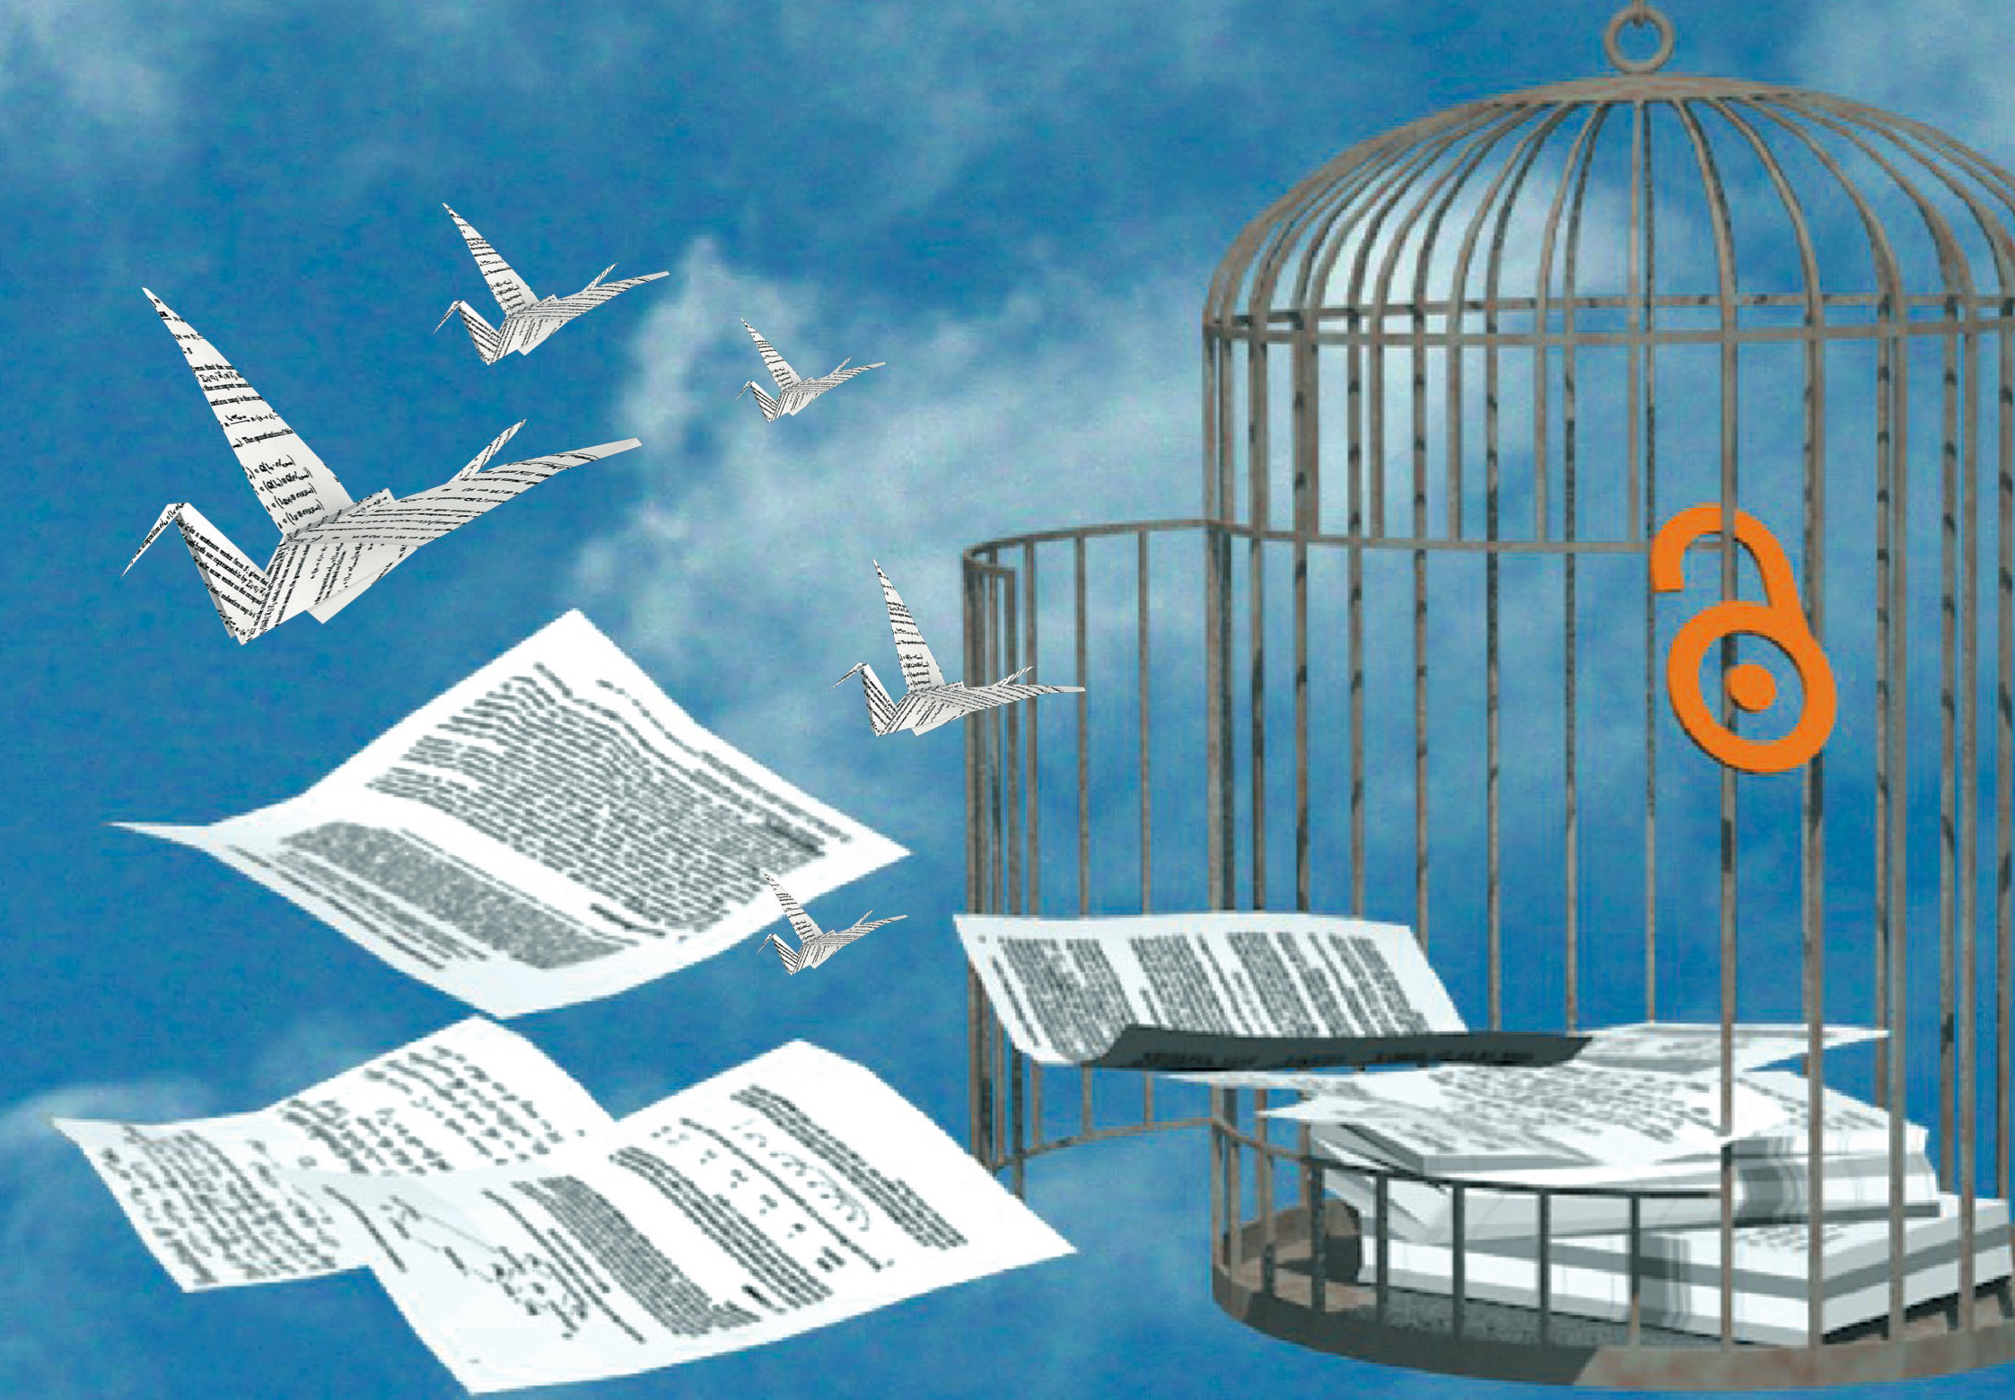
http://dissem.in
http://association.dissem.in
https://github.com/dissemin
@disseminOA
team@dissem.in

Slide 23
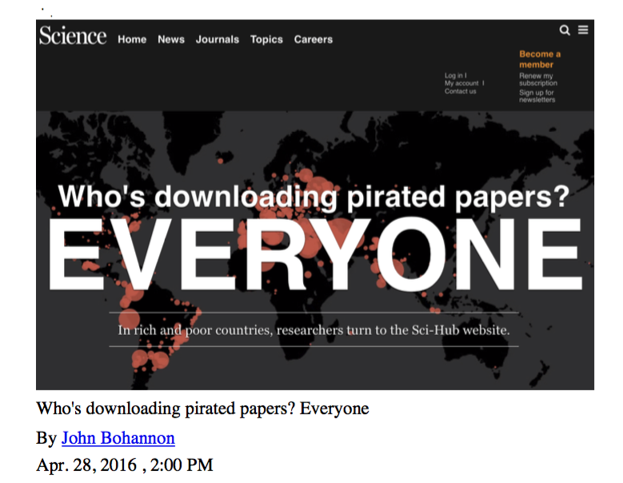
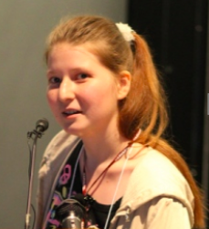
2015, Elsevier sued Sci-Hub and won
On June 21st 2017 Elsevier has won its lawsuit against Sci-Hub in a New York court:
Alexandra Elbakyan must pay them 15 million dollars in compensation.
http://openscience.ens.fr/OTHER/SCIHUB
2015_09_15_Alexandra_Elbakyan_answers_to_Elsevier_Prosecution.pdf

Slide 24
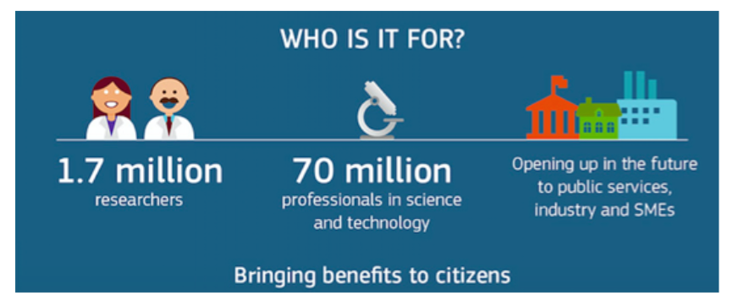
2016, Europe wants a legal Sci-Hub
On 4th April 2016 Carlos Moedas,
European Commissioner for Research, Science and Innovation,
launched the Amsterdam Call :
In 2016-2017, I was member of the RISE
(Research Innovation Science Expert)
group advising him on Open Science.
http://openscience.ens.fr/DECLARATIONS/
2016_04_04_EC_Amsterdam_Call_for_Action_on_Open_Science.pdf

Slide 25
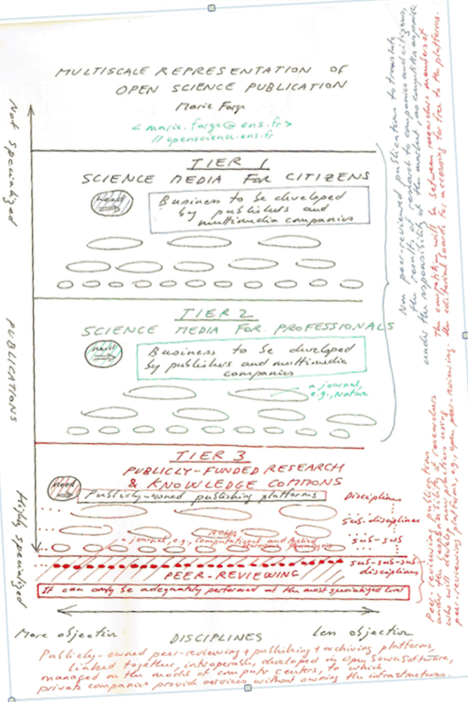
Popularization
level
2016, diagram on Open Science publication I made for Carlos Moedas
Popularization
of science
for citizens
For profit
playground of
commercial
publishers
Scientific
information
for companies
Peer-reviewed
articles done by and
for researchers
Non for profit
knowledge
commons
Specialization level
Objectivit level
http://openscience.ens.fr/MARIE_FARGE/ARTICLES/
2016_09_22_Diagram_for_Carlos_moedas_on_Open_Science_publishing.pdf

Slide 26
Popularization level
aaaaaaaaaaaaaaaaa
Multiscale representation of Open Science publication
a
It will encourage
scientific vocations
and help citizens
to understand and
appreciate research.
This should be a new playground
for publishers and media
Popularization
of science
for citizens
This should be a new playground
for publishers and media
It will reduce the delay
for research results
to produce innovations
companies can sell
Scientific
information
for companies
Peer-reviewing + Publishing + Archiving
for sharing scientific ideas, methods and results
through the Diamond OA platforms which are
linked, interoperable, developed in Open Source.
They are publicly-funded infrastructures
operated with the help of librarians,
for which publishers can provide services.
With those platforms
researchers will develop
new practices for
sharing their results
and checking their
reproductibility
Knowledge
Commons
for researchers
Objectivity level
Specialization level

Slide 27
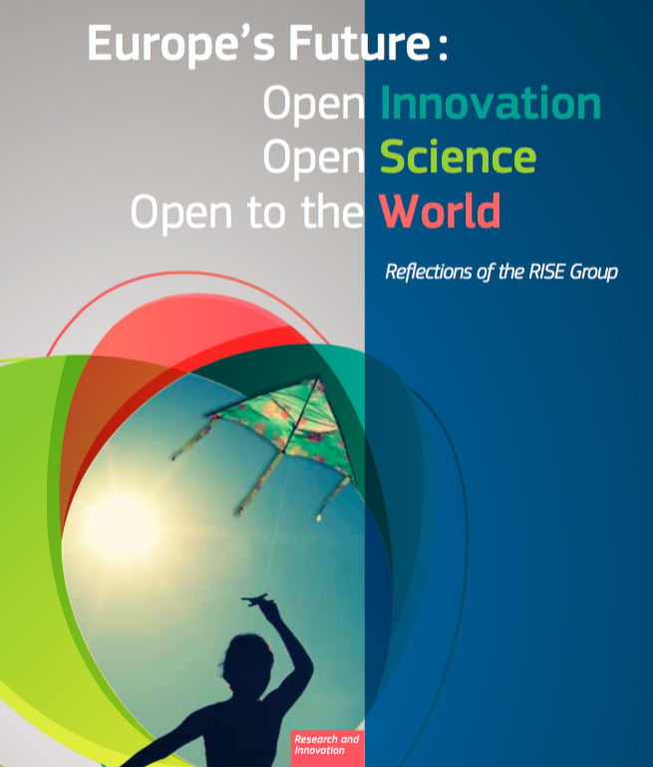
2017, OA peer-review and publishing
At the request of Carlos Moedas I wrote the chapter
on open access to peer-reviewed research publications
in a book published by the Commission in 2017.
I argued that research articles,
as well as peer review reports,
should be made available free of charge,
for both authors and readers,
to ensure that the results have been
validated and could be reproduced.
http://openscience.ens.fr/MARIE_FARGE_ARTICLES/
2017_05_15_BOOK_CHAPTER_FOR_THE_EUROPEAN_COMMISSION

Slide 28
Today, what should we do?
The publishers own the journals, the peer review reports and the bibliometric data that they use to control their `market' (i.e., our work) and ensure their profits.
They impose their Gold OA and the prices they decide on us.
This leads to present overproduction of articles and of predatory journals.
We should preserve the peer-reviewed journals which are useful to us
(those having good reputation and excellent practices)
and submit our research articles to those they prefer.
But we should no more give our copyright to anyone!
Before submitting an article to a journal,
we deposit our `Author Manuscript' (AM) in an open public repository,
under a CC license, ideally on arXiv in CC-BY.
https://www.coalition-s.org/
http://openscience.ens.fr/ABOUT_OPEN_ACCESS/DECLARATIONS/

Slide 29
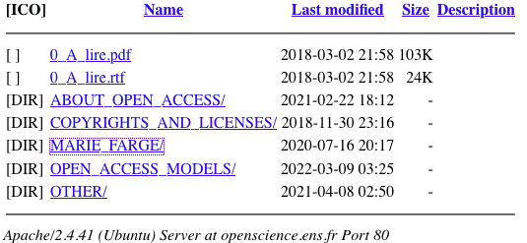
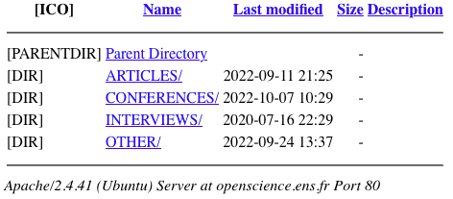
http://openscience.ens.fr
http://openscience.ens.fr/MARIE_FARGE
marie.farge@ens.fr
http://wavelets.ens.fr

